Slide 1
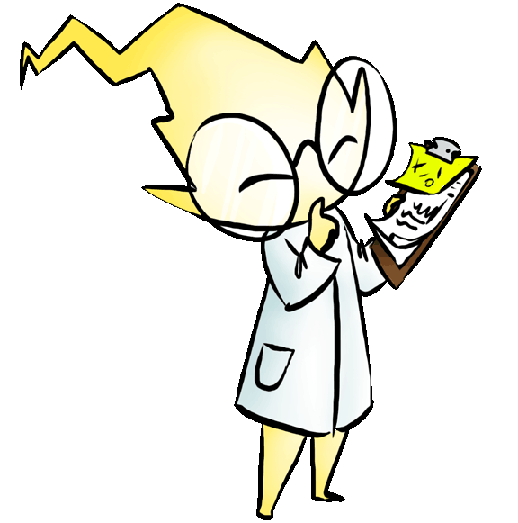
Energy
Architecture,
and Climate Change

Slide 2
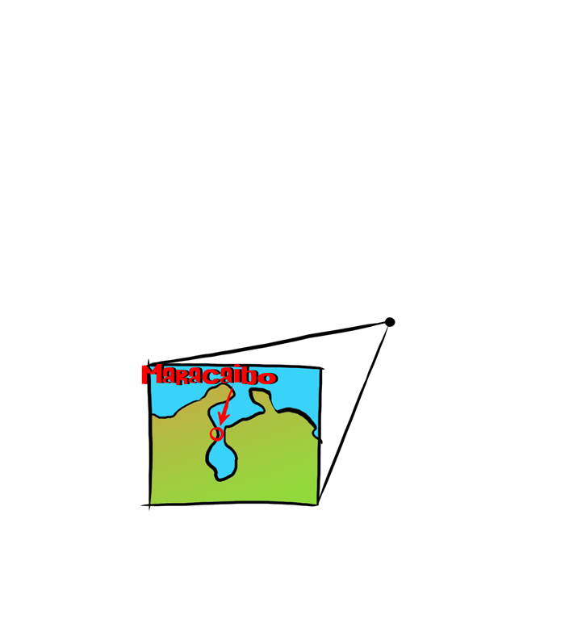
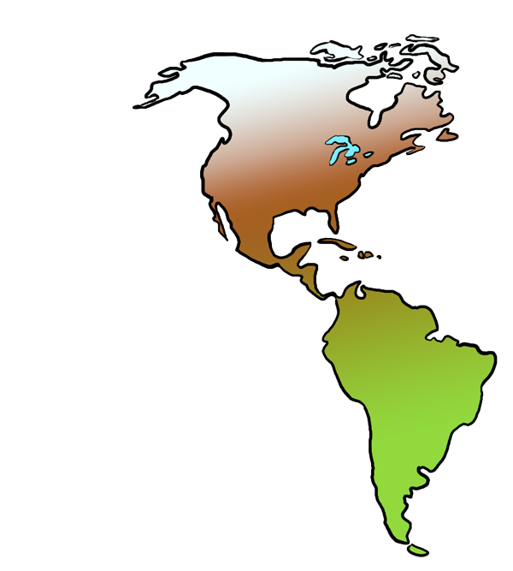

Slide 3
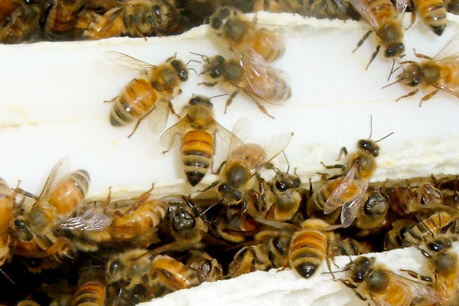
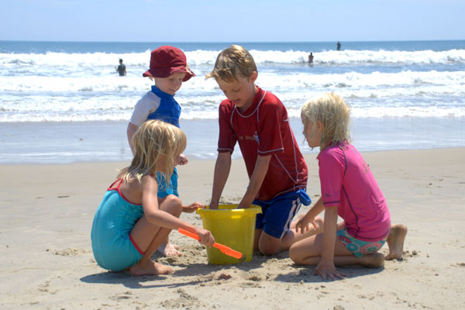
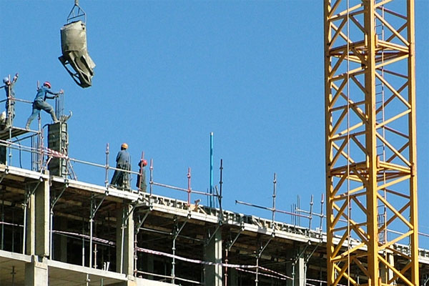
What is Energy?
Energy is the ability to do work

Slide 4
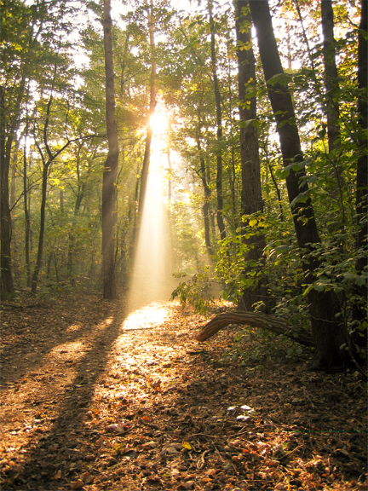
Energy is…
Light

Slide 5
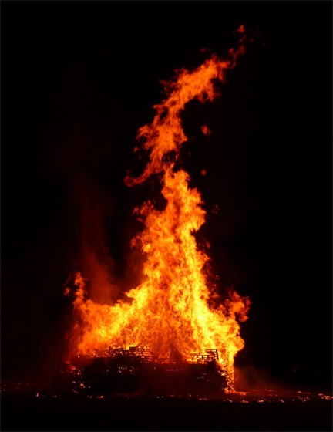
Energy is…
Heat

Slide 6
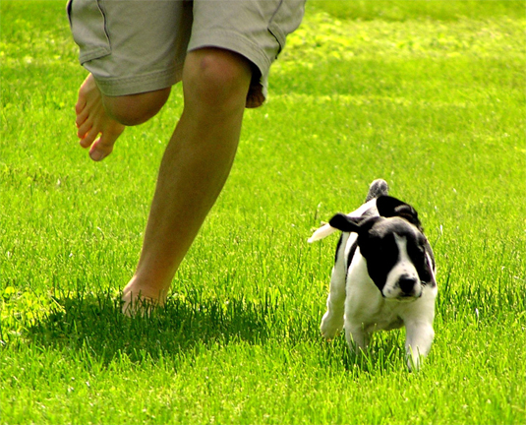
Energy is…
Motion

Slide 7
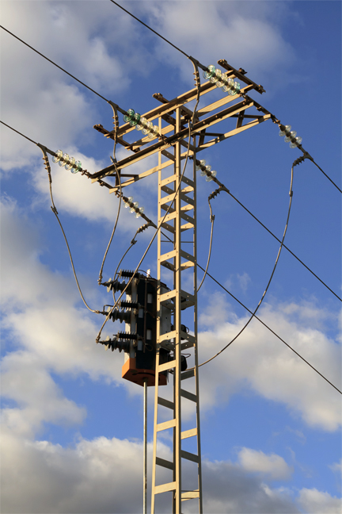
Energy is…
Electricity

Slide 8
Energy is…
Sound

Slide 9
Where does Energy come from?
Energy is all around us,
in everything and everyone.
Energy makes your body grow,
and makes things move.
Energy is in the light we see
and the food we eat.
We need Energy for everything we do.

Slide 10
Let’s draw Energy……

Slide 11
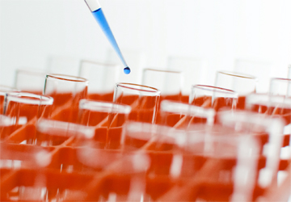
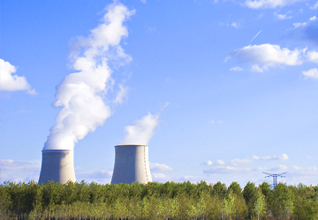
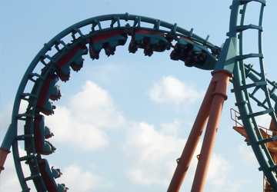
Other types of Energy…
Chemical
Nuclear
Gravity

Slide 12
What types of Energy are there?
There are 2 types of energy that we use every day to generate electricity:
Nonrenewable Energy
&
Renewable Energy

Slide 13
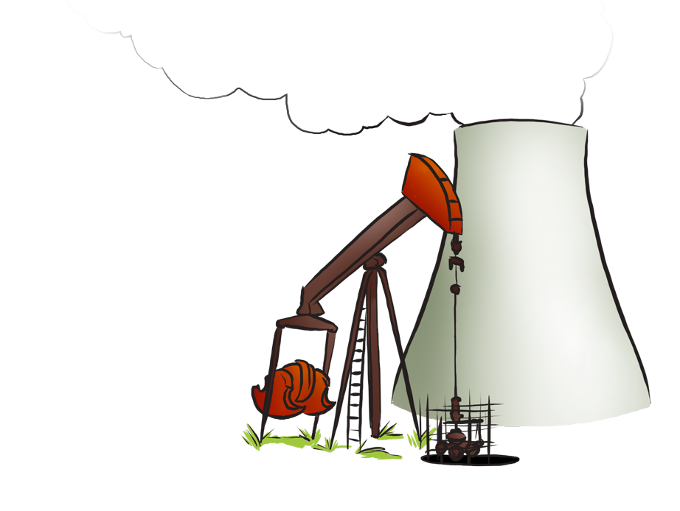
Nonrenewable Energy
Nonrenewable Energy comes
from resources that can’t be
replenished easily:
Oil
Coal
Uranium
Natural Gases

Slide 14
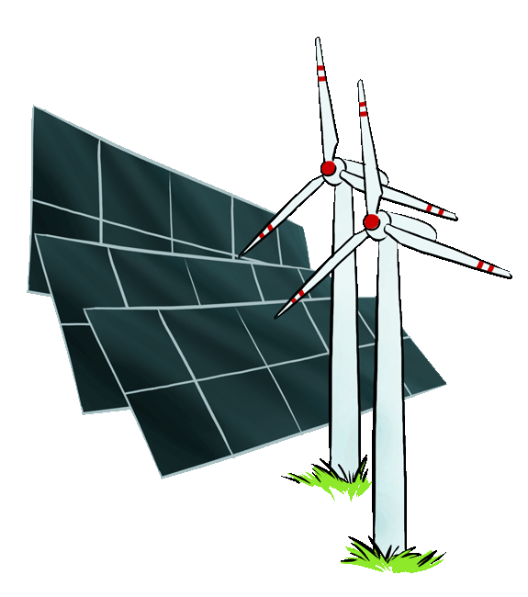
Renewable Energy
Renewable Energy comes
from resources that are
easily replenished:
Solar energy
Wind energy
Geothermal energy
Water energy

Slide 15
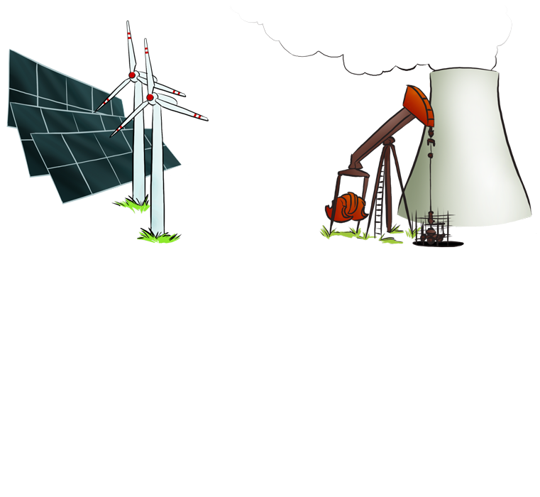
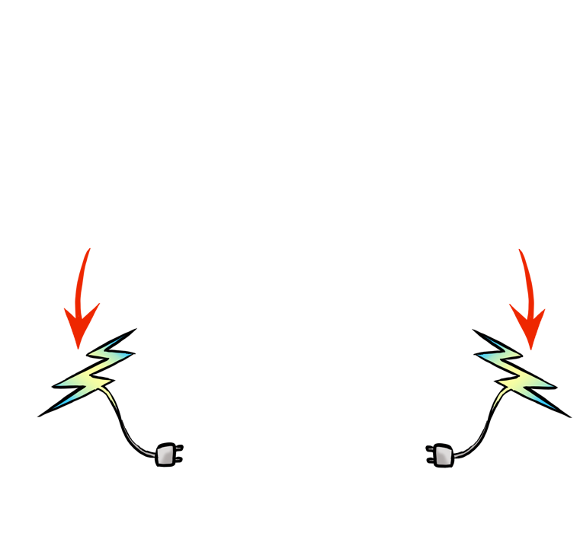
How We use Energy
We use both Renewable and Nonrenewable Energy to power our homes – our televisions, computers, refrigerators and our water heaters

Slide 16
Energy I.Q.
How much Energy in the United States comes from renewable resources?
Almost all
Half
A quarter of the energy
Just a little bit (8%)
d. Just 8%

Slide 17
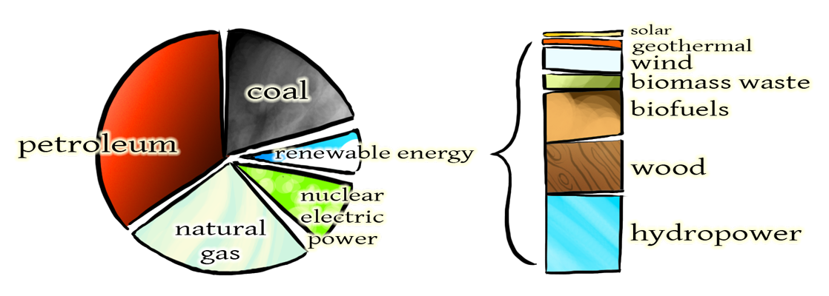
Energy I.Q.
Almost all the energy used in the USA is non renewable. Which means that we will run out of energy.

Slide 18
Why use Renewable Energy?
Here are some of the reasons why it’s better to use Renewable Energy:
We will not run out of Renewable Energy
Renewable Energy is cleaner
Renewable Energy saves fossil fuel resources for future generations

Slide 19
What is Climate Change?
Climate Change is the slow change
in the planet’s temperature
over a long period of time
Climate Change is caused by
an increase in the amount of
Greenhouse Gases in the atmosphere

Slide 20
For thousands of years, Greenhouse Gases have been stable…
…in the last 250 years,
Greenhouse Gases have risen steadily as we became more dependent on fossil fuels.

Slide 21
https://www.youtube.com/watch?v=bak50U6HiRk
https://www.youtube.com/watch?v=bak50U6HiRk

Slide 22
Effects of Greenhouse Gases
Whenever we use fossil fuels to create electrical energy, we release some of the carbon from those fuels into the atmosphere.
These are the Greenhouse Gases that affect Climate Change.

Slide 23
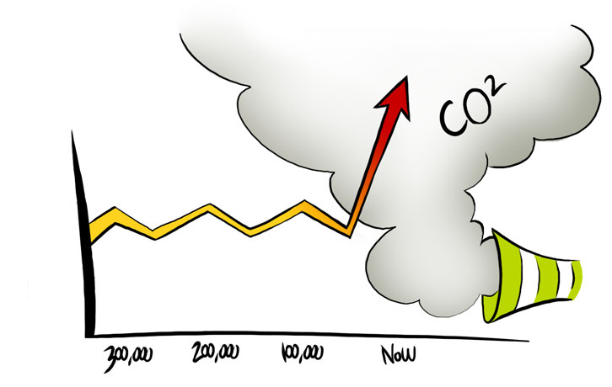
Time in years

Slide 24
Climate Change Indicators
Here are several signs that prove our climate is changing…
We can see how climate change affects the temperature of our planet over time

Slide 25
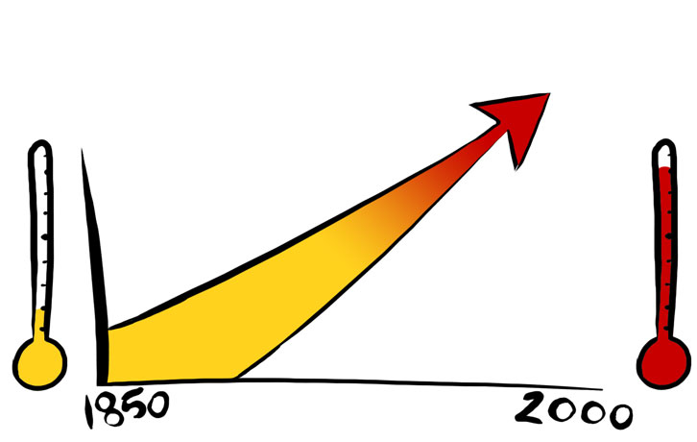
Climate Change Indicators
Average Global Temperature
As the temperature rises…

Slide 26
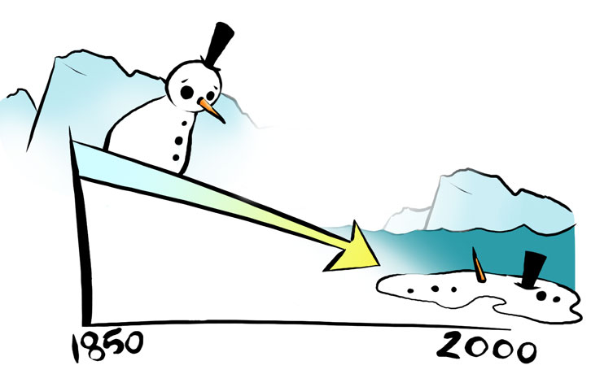
Climate Change Indicators
Arctic Snow Cover
…the polar ice caps melt…

Slide 27
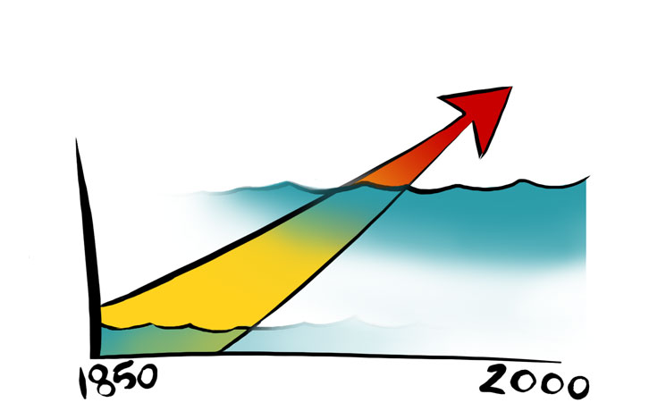
Climate Change Indicators
Global Sea Level
…and the sea level rises.

Slide 28
Our Planet is changing constantly…
Things come…
…and things go.

Slide 29
Our Planet’s climate is no different…
Sometimes it’s hot…
…sometimes
it’s cold.

Slide 30
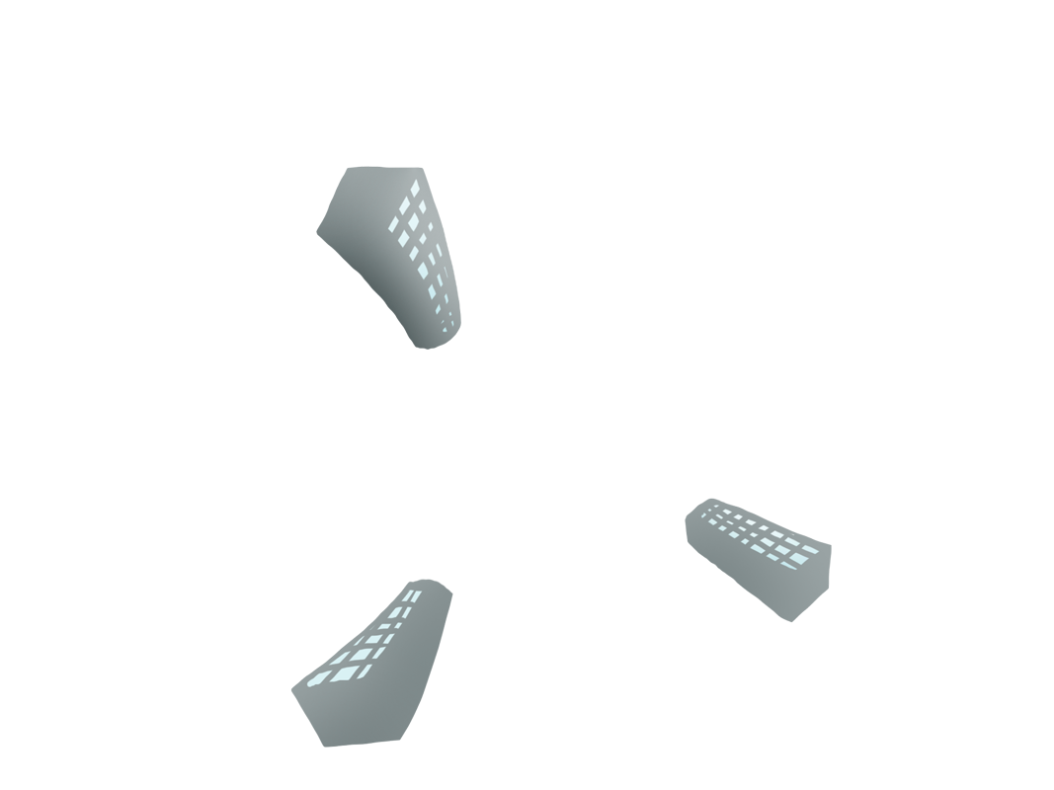
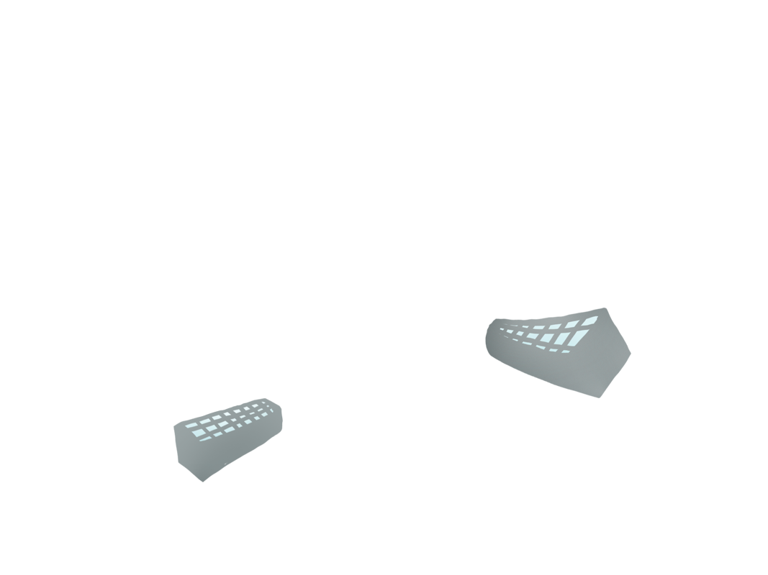
But now, something else is happening…
Modern industry and technology have changed our lives…
…but are they changing our planet too?

Slide 31
Many leading Scientists think so!

Slide 32
So what’s the big deal?
Floods
Loss of Habitats
Droughts
The
warming up of our planet could cause…

Slide 33
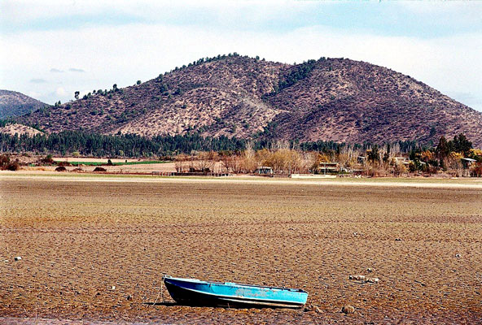
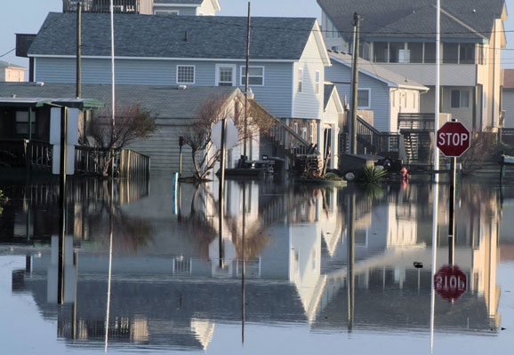
Droughts and Flooding
Less rain can mean less water for some places, while too much rain in other areas can cause terrible flooding
Towns and cities by the ocean are at greater risk of flooding from the rising sea level

Slide 34
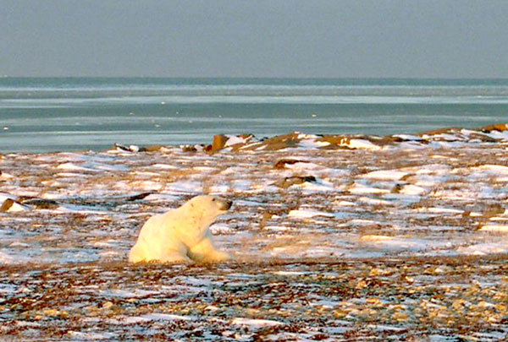
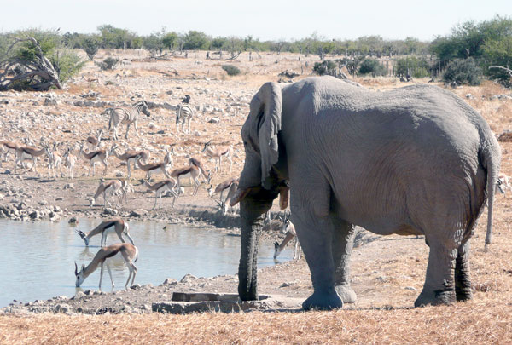
Loss of Habitat
Plants and animals that have adapted to cold weather might not have a suitable place to live
Up to one fourth of all the plants and animals on Earth could become extinct in 100 years

Slide 35
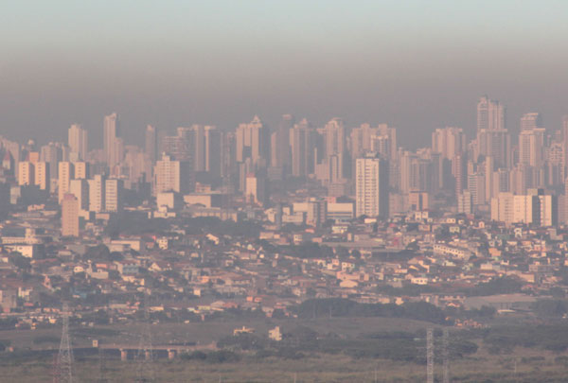
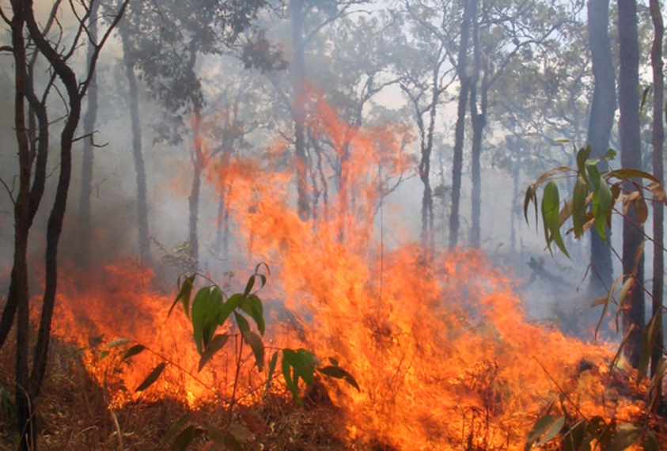
Scorching Summers and Fires
Heat waves, storms and air pollution threaten our health, especially in children and the elderly
Hot, dry conditions allow wild fires to start more easily, spread faster and burn longer

Slide 36
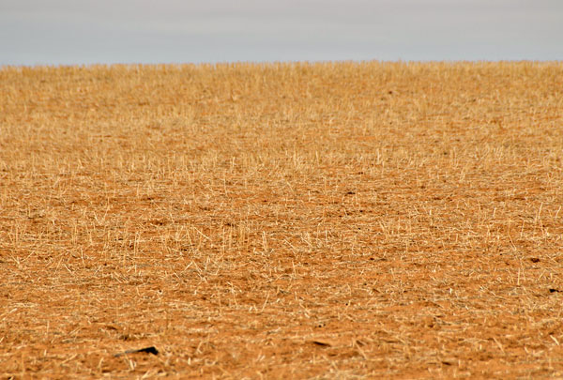
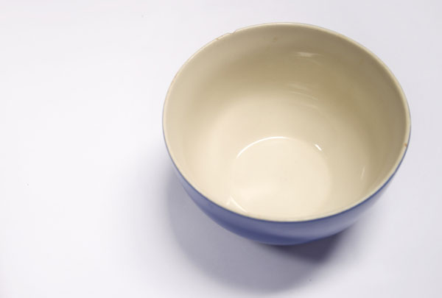
Lack of Food
Certain crops will no longer grow in the warmer climate, and there will be less water for irrigation
With less crops and less water, there will also be less food for everyone

Slide 37
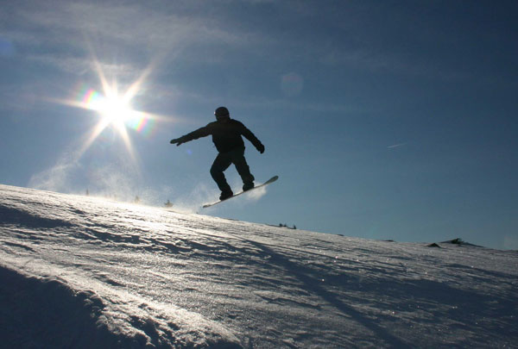
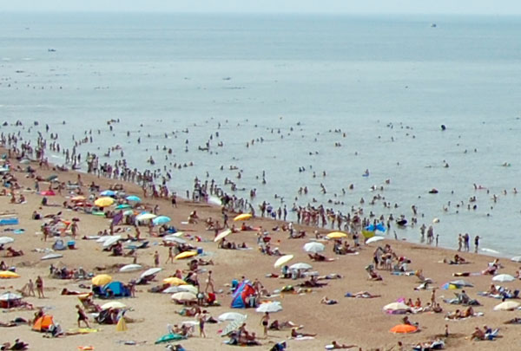
Recreation
Higher temperatures will affect ski resorts and other cold weather activities like outdoor ice skating
As the sea level rises, beaches will become more crowded, and may disappear over time

Slide 38
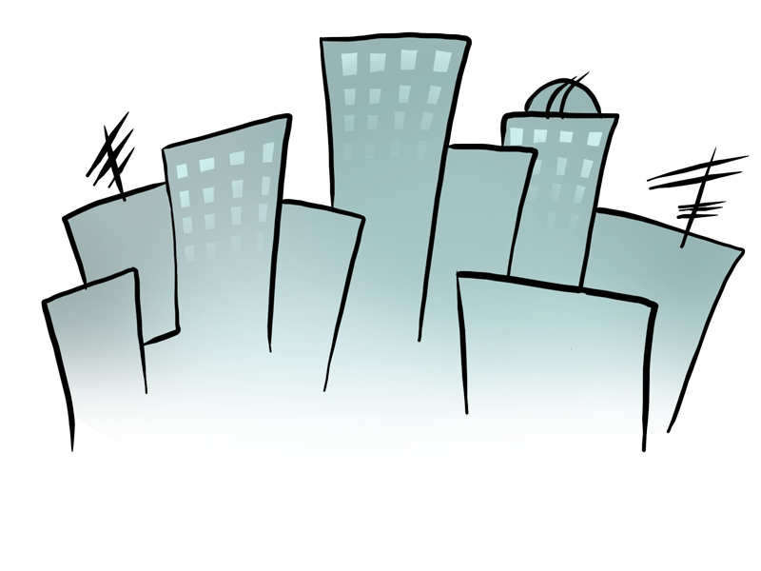
We are responsible for
the recent Climate Change.

Slide 39
Carbon Elephant Connection
2008 Carbon Emissions Per Capita
in TONS

Slide 40
So what can we do?
There are many ways to lessen our
impact on the environment…
…and make our world a cleaner, greener place to live.

Slide 41
Reducing our Impact
How do we reduce our impact on climate?
Turn off the lights
Drive less – try walking to school
Turn off the TV or video game console when you are not using it
Use a fan or open a window instead of an air conditioner

Slide 42
Reducing Energy Use
We can reduce our emissions by reducing energy use:
Use Renewable Energy sources to provide heat, light and electricity
Use Solar Powered Cookers to cook food
We will go outside to see some Solar Powered Cookers in action!

Slide 43
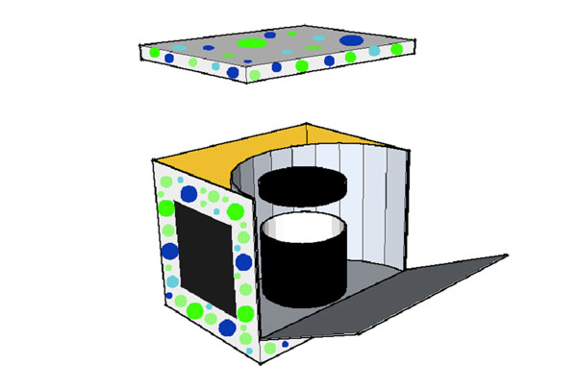
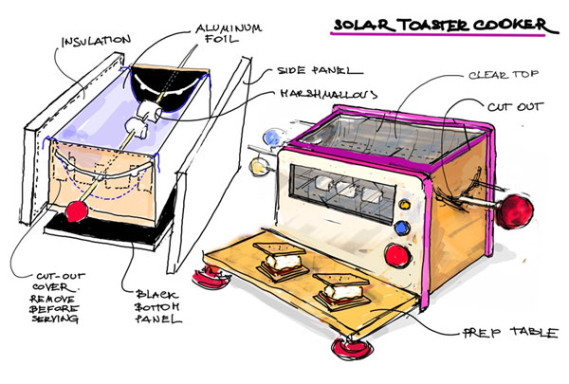
Solar Powered Cookers
Solar Cooker 1 team:
Cynthia Garcia Vanessa Ortega Katrina Banzon Iomara Martinez Diane Yabut
Solar Cooker 2 team: Joe Figueras Arlette Mulford Von Dominguez Kristen Tuerk Abner Morales

Slide 44
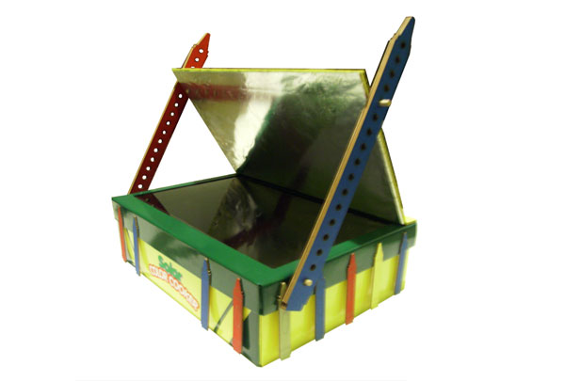
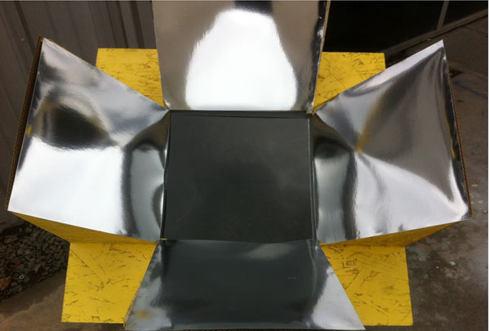
Solar Powered Cookers
Solar Cooker 3 team:
Maro Asipyan Matthew Terry Rezvan Agahi
Jaime Moreno
Solar Cooker 4 team:
Chance Jackson
Thomas Freed
Keyur Maru
Sem Luong

Slide 45
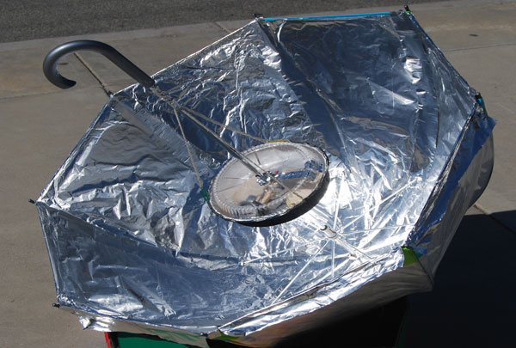
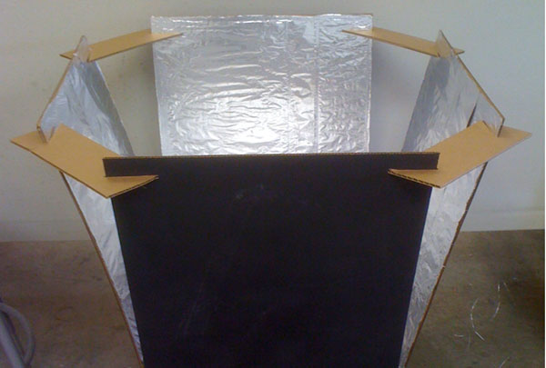
Solar Powered Cookers
Solar Cooker 5 team:
Megan Miller
Margaret Jamison
Leina Naversen
Jane Schimidlapp
Firouzeh Shariaty
Solar Cooker 6 team: Andrew Sidler
Jeffrey Tseng
Sung Min Park
Sonia Kohar
Ana Karen Loera

