Slide 1
Water...
...and Energy

Slide 2
Water...
...and Energy
Only 3% of the water on this planet is usable.
You can help preserve water for future generations by conserving the amount of water you use.
We need energy for everything we do.
We can help our planet by using Renewable Energy to power our vehicles and our homes.

Slide 3
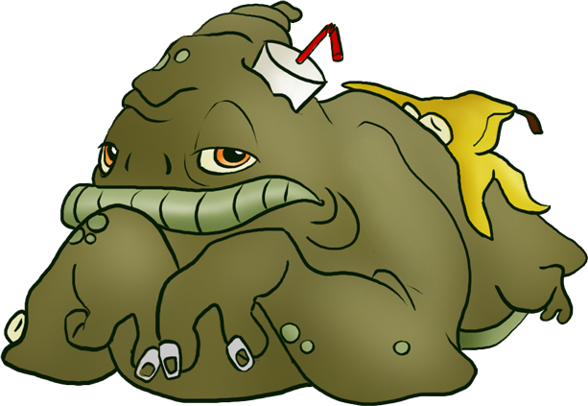
Waste
and
Waste Management

Slide 4
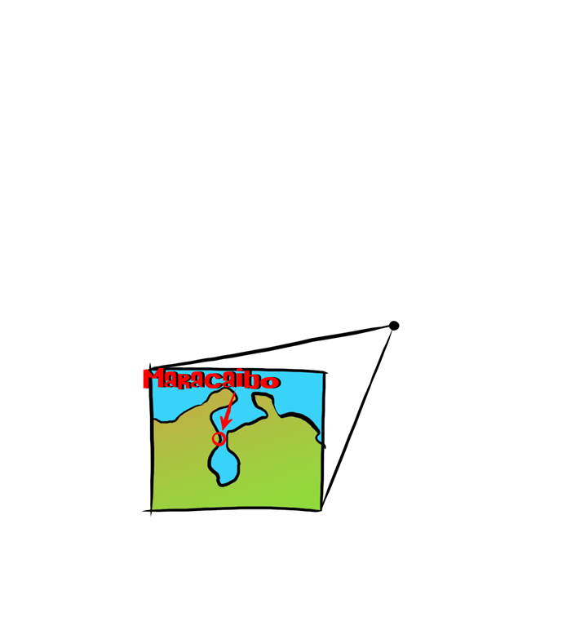
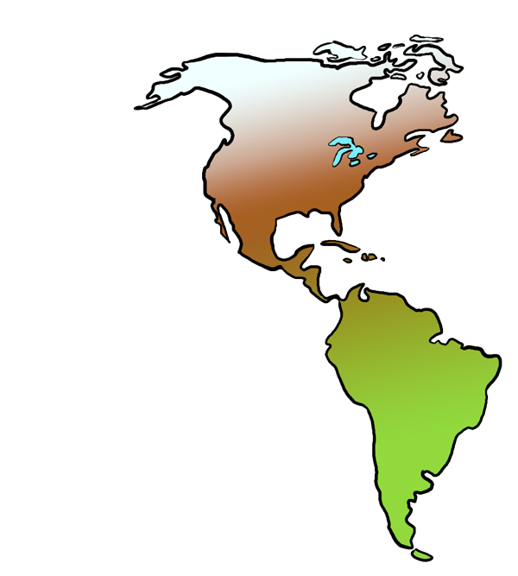

Slide 5
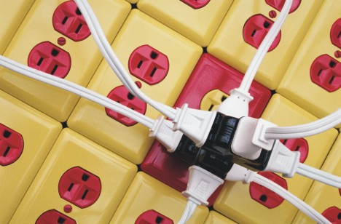
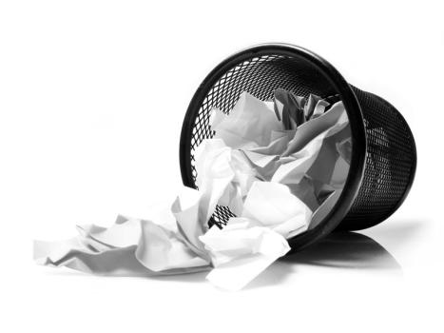
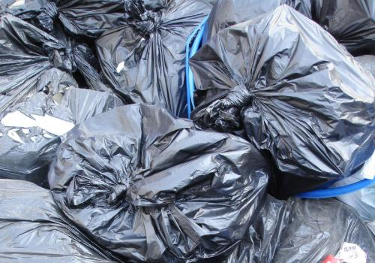
What is Waste?
Waste is using something carelessly

Slide 6
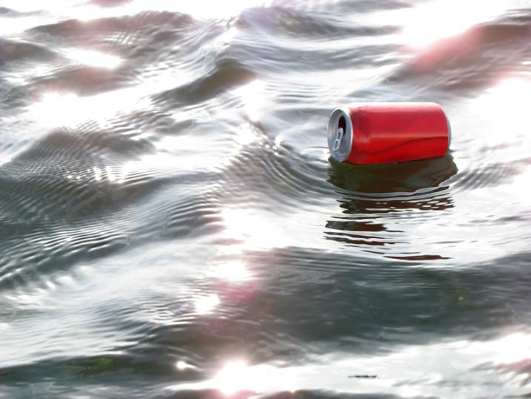
Waste is...
To Squander

Slide 7
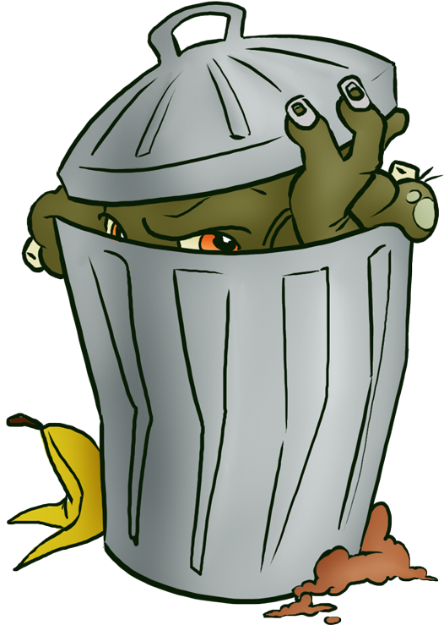
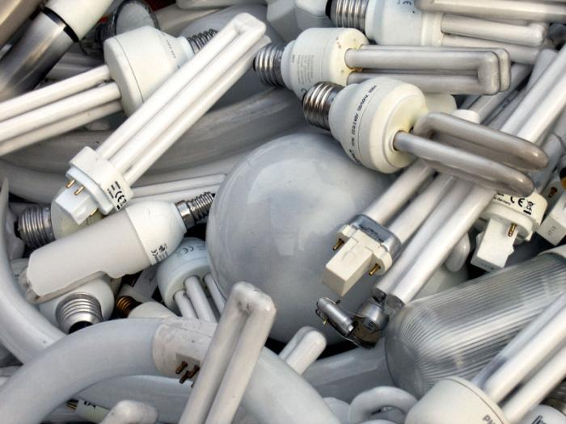
Waste is...
Discarded and unused materials

Slide 8
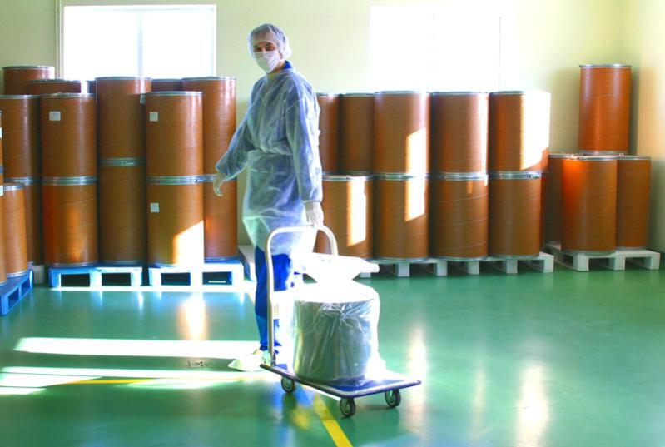
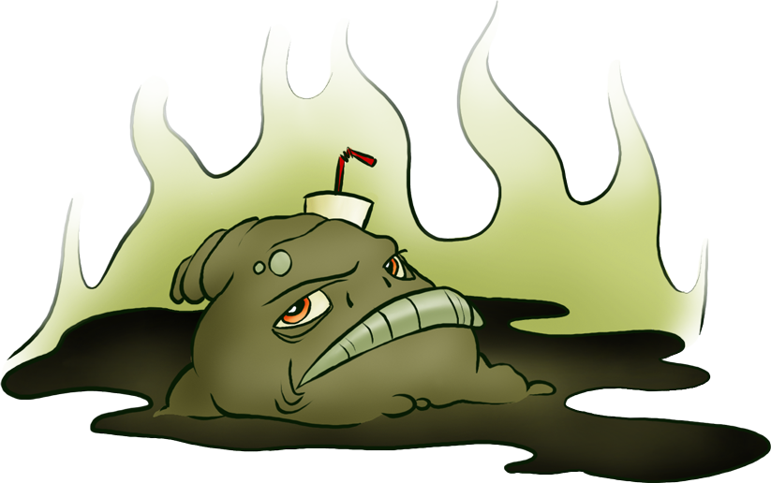
Waste is...
Pollutants and chemicals

Slide 9
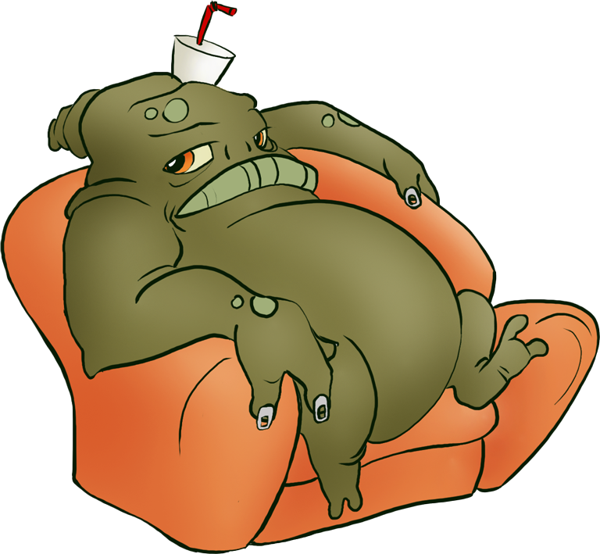
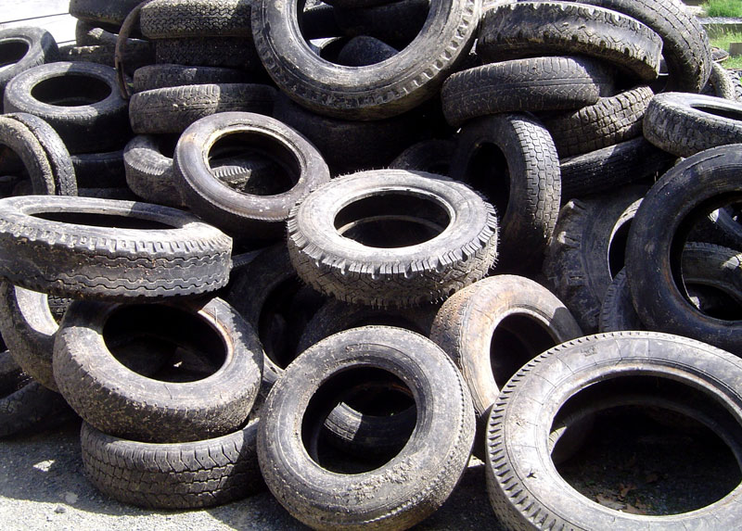
Waste is...
Materials that aren’t being used

Slide 10
Waste I.Q.
How much trash does the average person in the U.S. throw away every day?
1 lb
2 lbs
5 lbs
7 lbs
d. 7 lbs

Slide 11
Waste I.Q.
What country produces the most garbage per year?
Mexico
United States
Spain
China
b. United States

Slide 12
Waste I.Q.
The United States always falls in the top 5 countries that produce the most garbage.
Mexico, China and Spain all produce large amounts of garbage every year, but the U.S. produces the most.
The U.S. makes up only 5% of the population on the planet, yet consumes 30% of all the resources and churns out 30% of all the waste.

Slide 13
Waste I.Q.
Garbage production in the U.S. has doubled over the last 30 years.
About 30% of all U.S. products are only used once then thrown away.
95% of ALL plastic, 66% of ALL glass and 50% of ALL aluminum beverage cans do not get recycled; instead they get burned or buried.

Slide 14
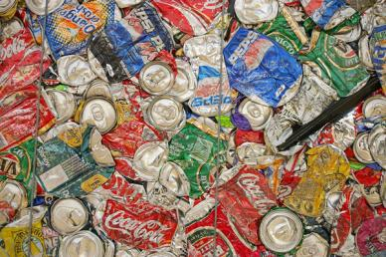
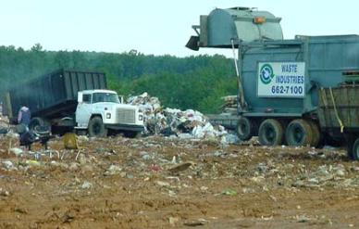
Where does the waste go?
Into our air
Into our soil
Into our water
Sometimes to trash conversion and recycling plants
Most of our trash goes to landfills

Slide 15
Where does the waste go?
About 57% of all our trash is buried in landfills
95% of ALL plastic, 66% of ALL glass and 50% of ALL aluminum beverage cans do not get recycled; instead they get burned or buried.
Just because you can’t see the trash doesn’t mean it’s not a problem any more.

Slide 16
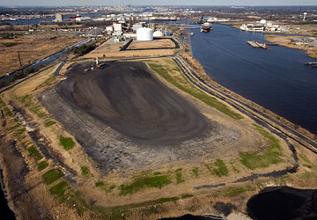
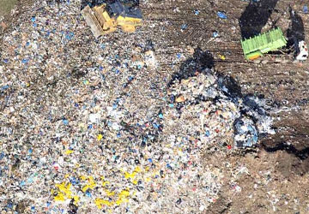
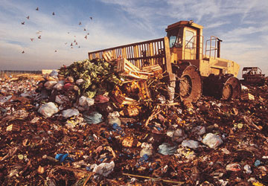
What is a Landfill?
A landfill is a carefully engineered basin in the ground where we hide our waste.
Landfills are like a double-lined bathtub – the aim is to stop any waste leaking out into our water supply – especially our groundwater.
Bathtubs can often leak out in 2 ways – from a crack in the bottom, or by flowing over the top.

Slide 17
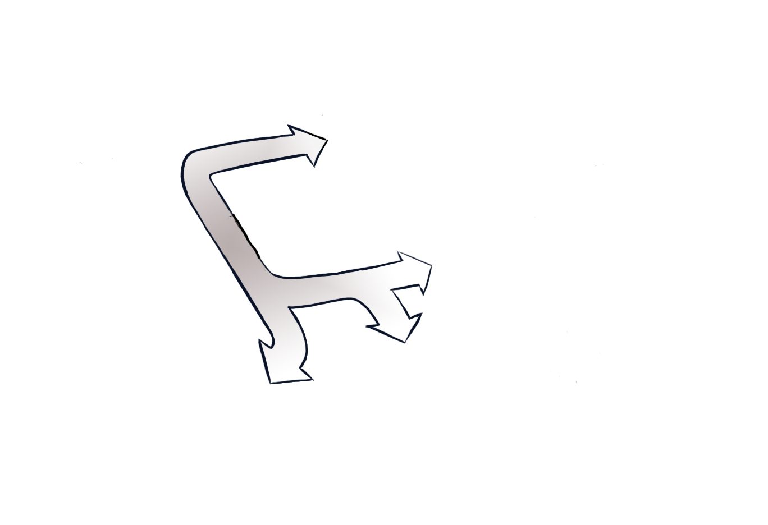
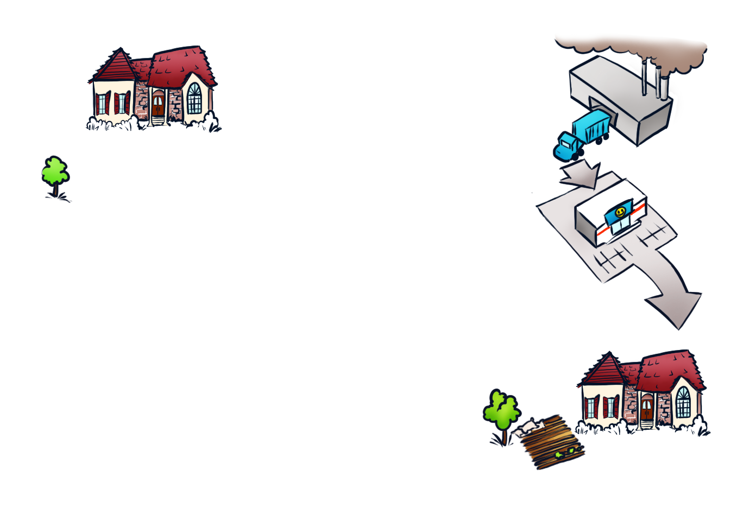
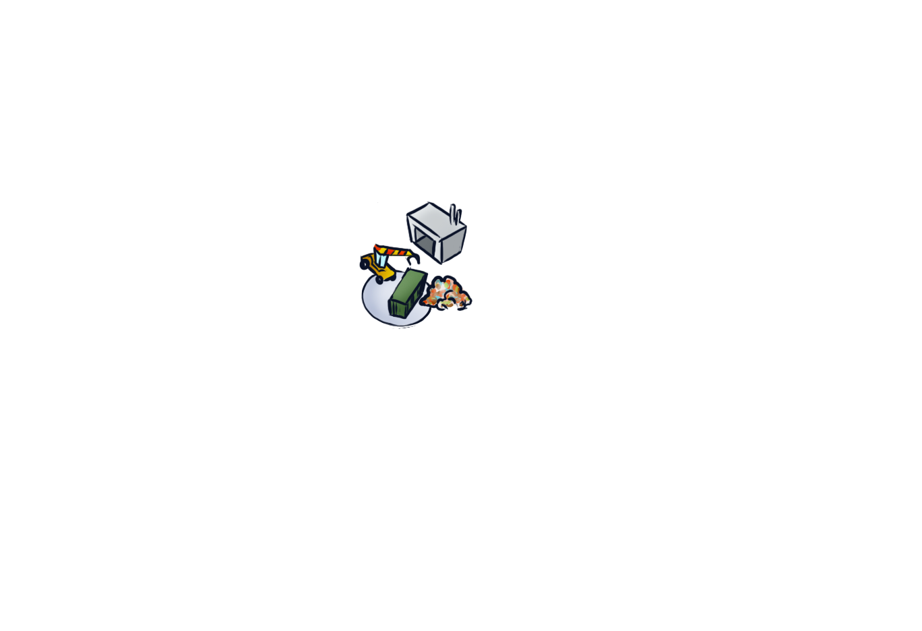
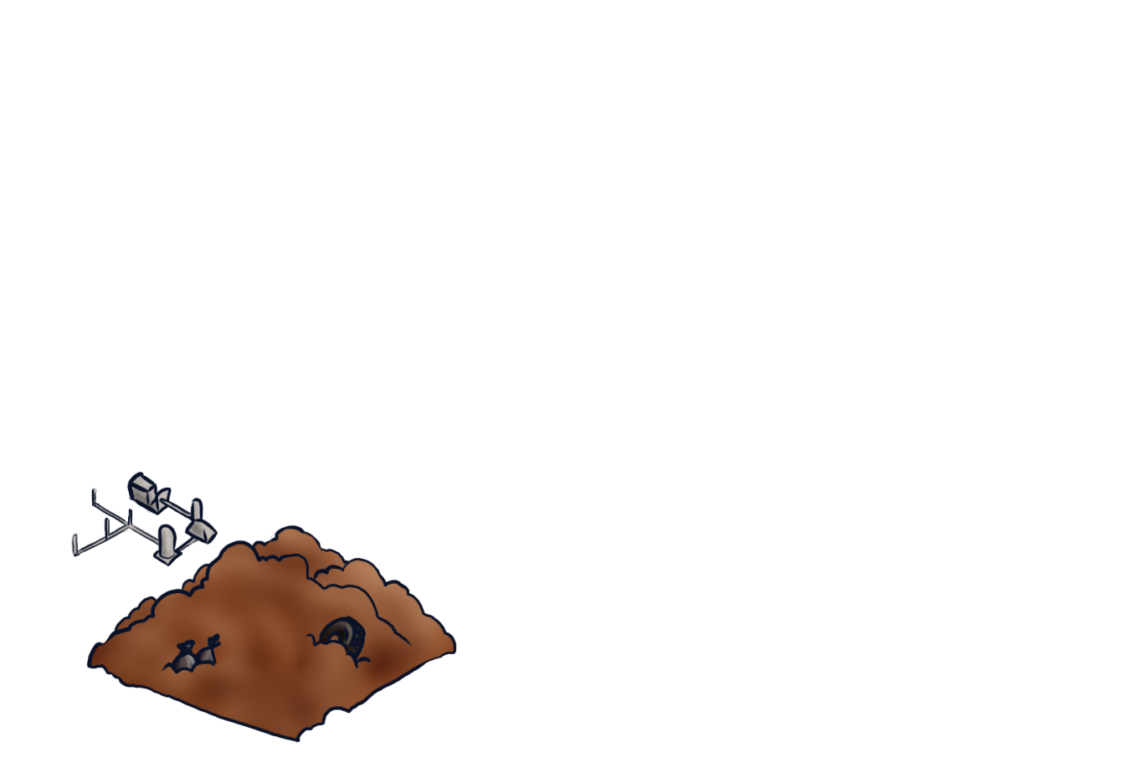
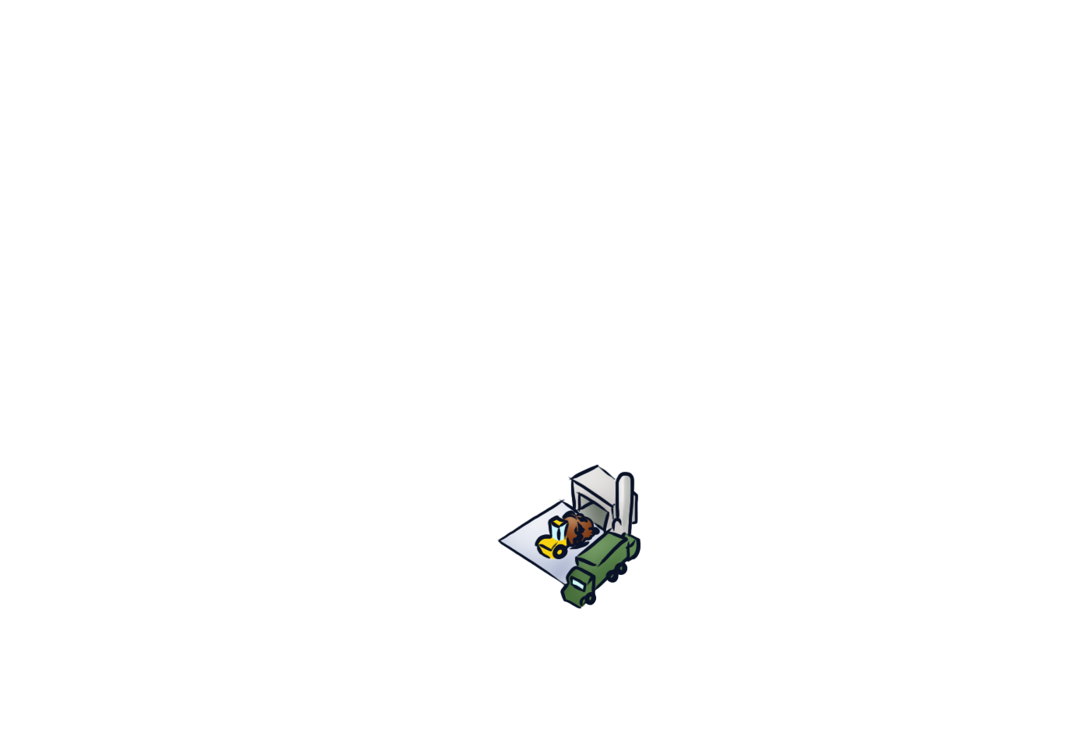
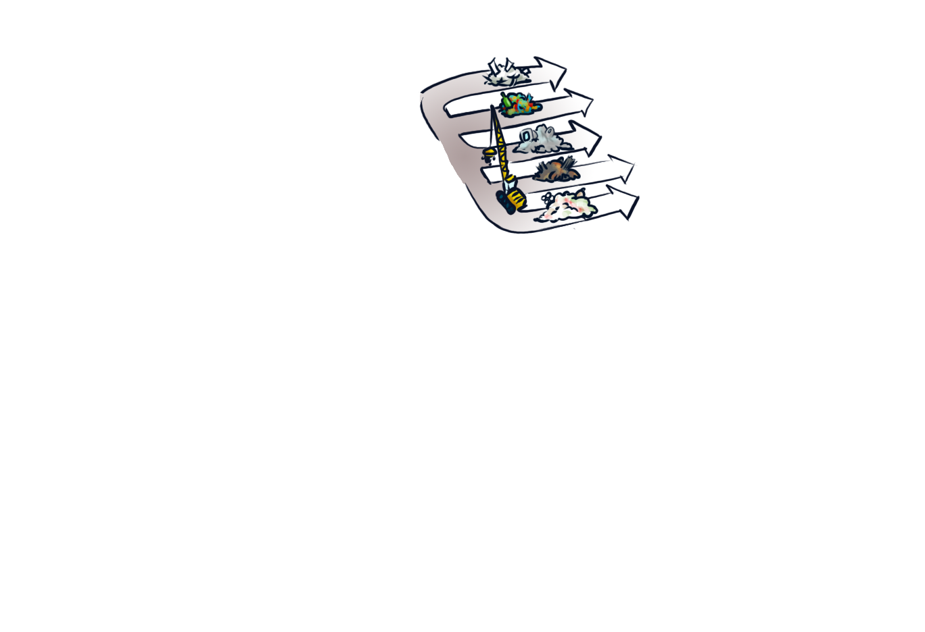
Manufacturing
plant
Recycling center
your homes
Paper
Glass
Ewaste
Metal
plastic
Trash
pickup
Transfer
station
Retail Stores
Composting
Landfill gas collection
Waste to energy plant
Landfill site
To your homes!

Slide 18
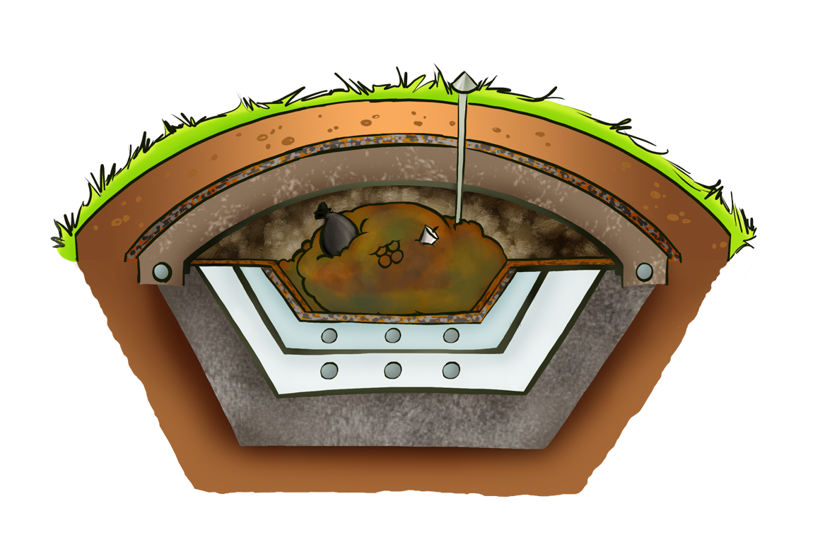
What is a Landfill?

Slide 19
Landfill Waste I.Q.
How long does it take for a plastic bag, bottle or cup in a landfill to decompose?
1 year
5 years
20 years
Hundreds of years
d. Hundreds of years

Slide 20
Landfill facts
The U.S. has 3071 active landfills, and over 10,000 old municipal landfills according to the Environmental Protection Agency
Contaminated air and water from landfills is hazardous – Municipal landfills can accept this hazardous waste under federal law.
ALL landfills will eventually fail, and leak this hazardous waste into the surrounding ground and surface water.

Slide 21
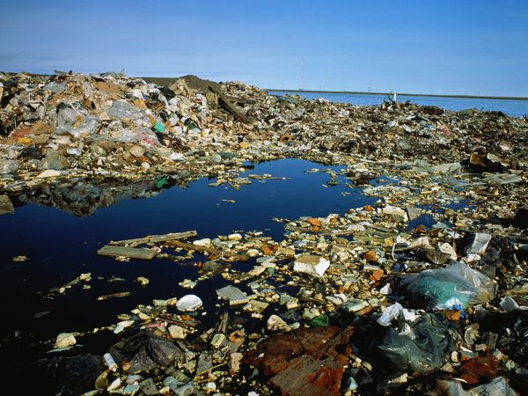
So, what is the problem?

Slide 22
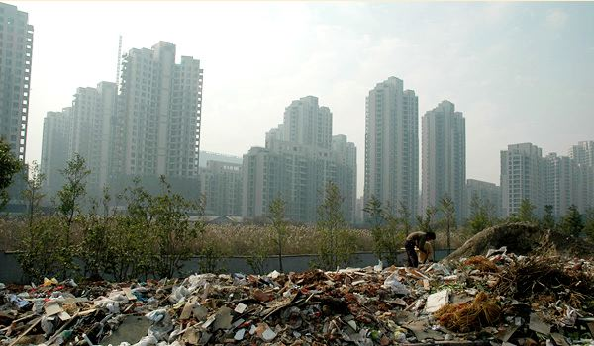
So, what is the problem?

Slide 23
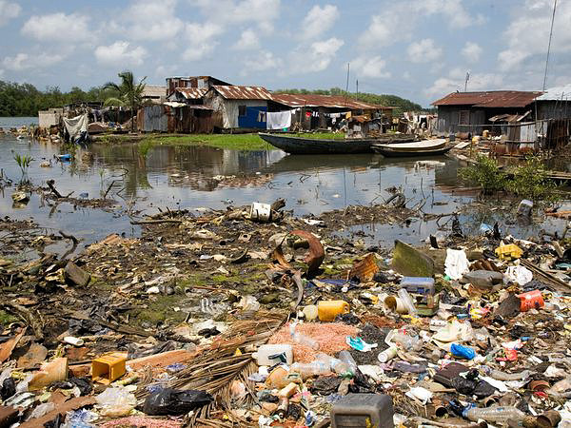
So, what is the problem?

Slide 24
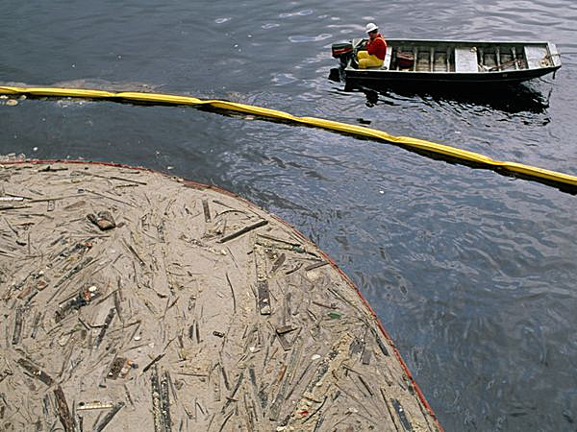
So, what is the problem?

Slide 25
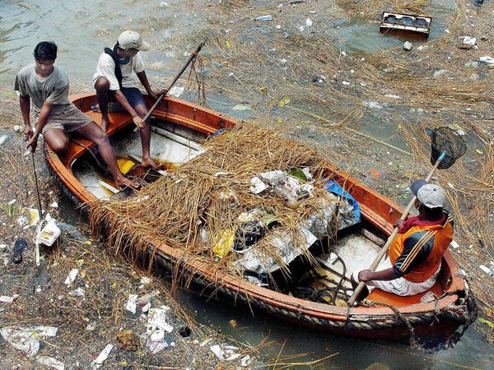
So, what is the problem?

Slide 26
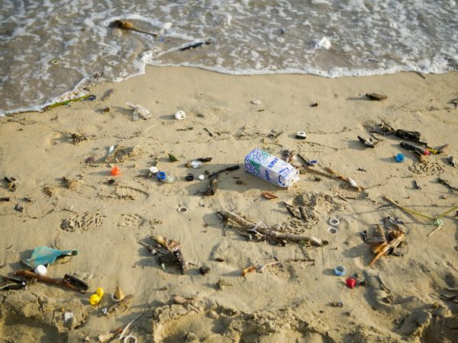
So, what is the problem?

Slide 27
The Problem... Too much waste!
We are running out of space for landfills.
Very little of our solid waste is being converted into usable energy.
Not enough people recycle.
Recycling also consumes energy.
People don’t deal with waste appropriately!

Slide 28
Why we need to deal with our waste
Our planet has limited resources.
Less waste means we use less energy.
Reduces water, soil and air pollution.
There is no space left for our waste.

Slide 29
How you can make a difference
We need to better manage our waste.
Reduce how much stuff we use.
Reuse materials
Recycle materials
Share materials
Composting
Knowing what you should and shouldn’t put in trash cans

Slide 30
Reduce your waste
What ways can you think of to use less?
Discipline ourselves to be less wasteful.
Use less water
Use less energy & electricity
Do we need so much stuff?
Do you always need new things, just because they are new?
Print less copies
Use less paper towels

Slide 31
Reuse materials
What ways can you think of to reuse items you would normally throw away?
Be Creative!
Reuse materials for the same purpose.
Take better care of your things so they can be used over and over again.
One person’s waste could be another’s treasures.
Rethink what you consider waste.
There are creative ways to reuse materials.

Slide 32
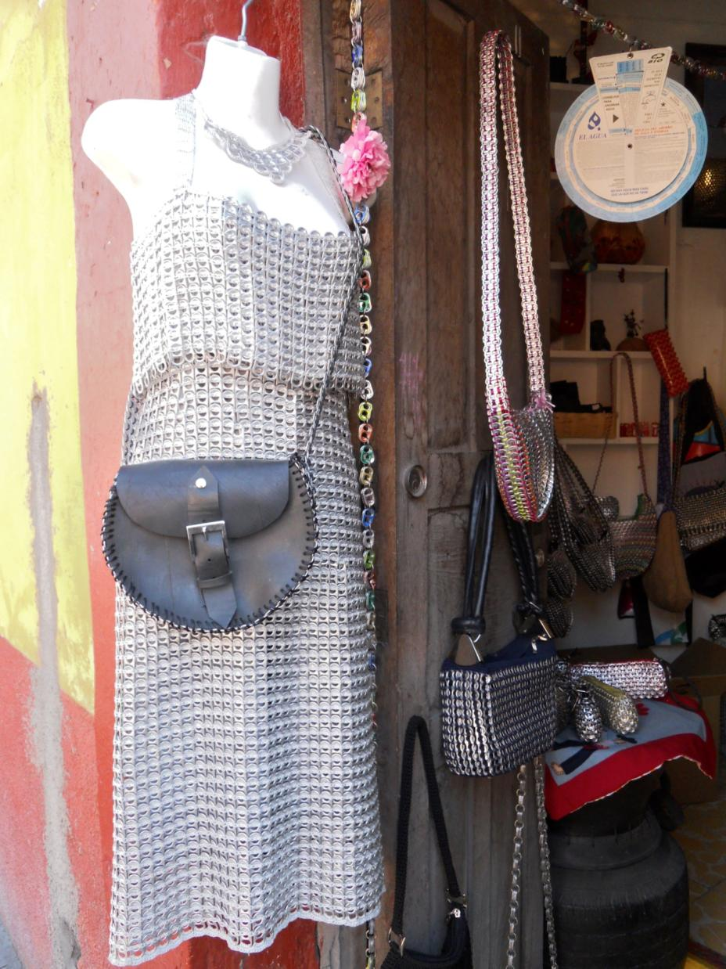
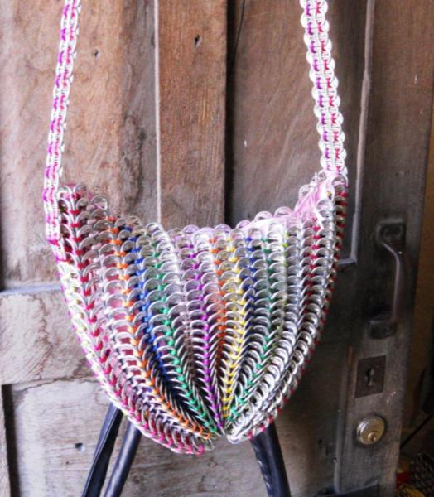

Slide 33
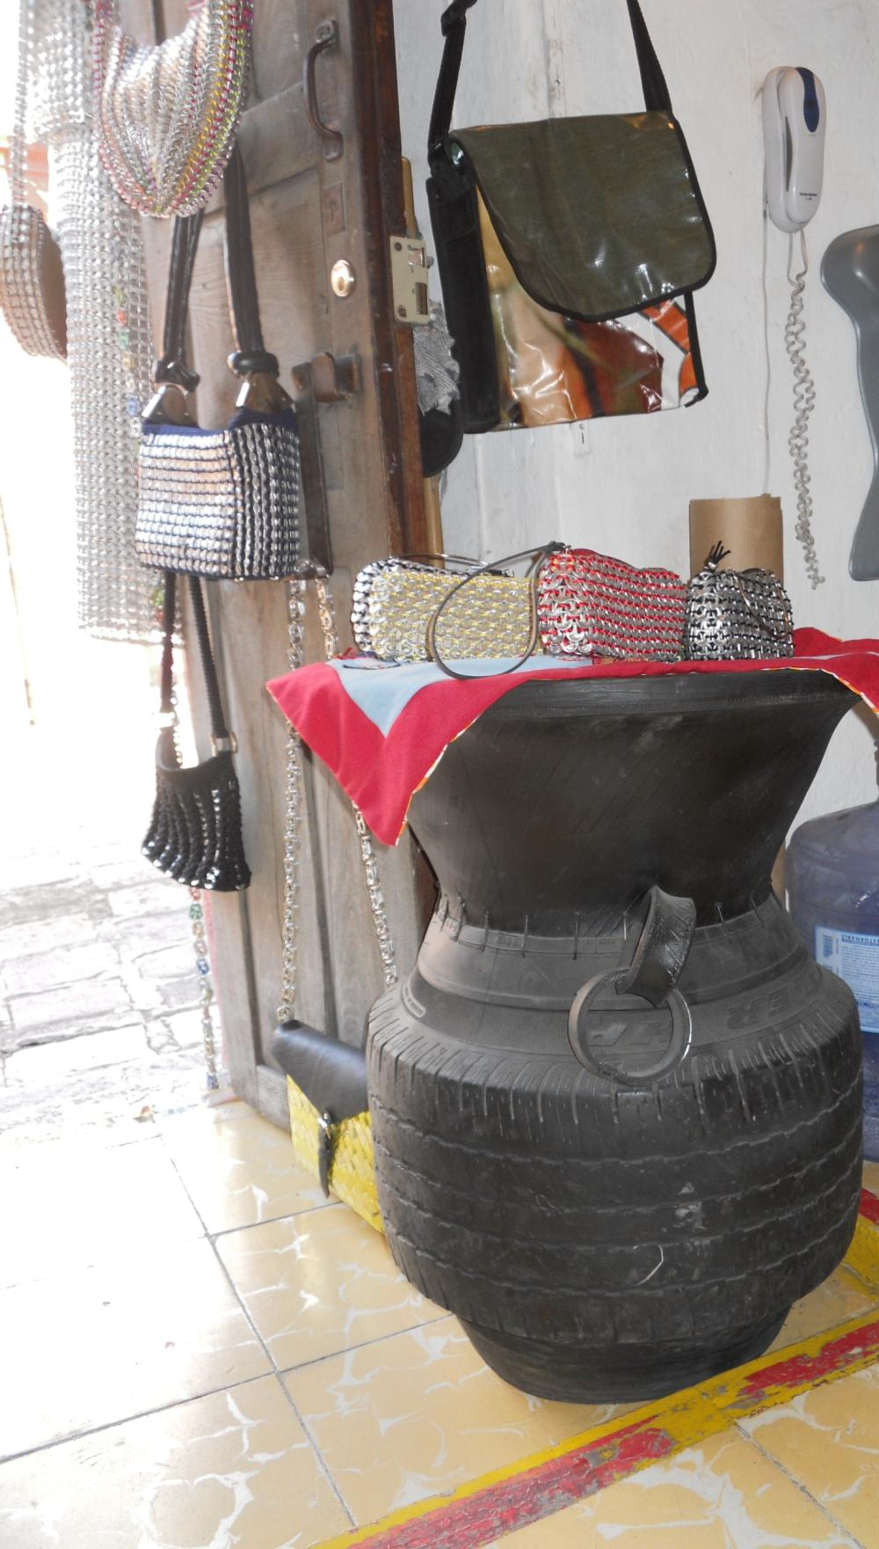
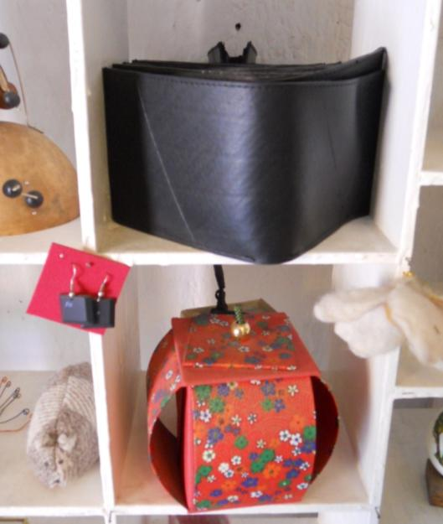

Slide 34
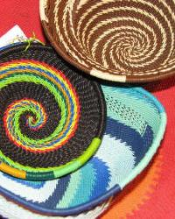
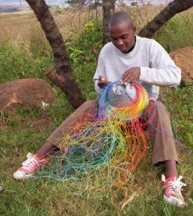

Slide 35
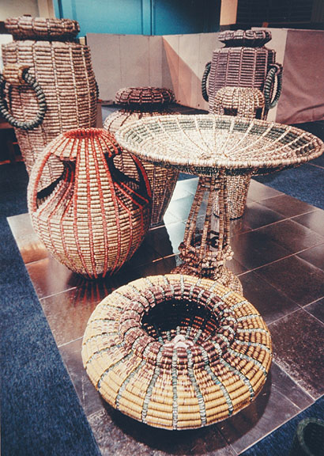
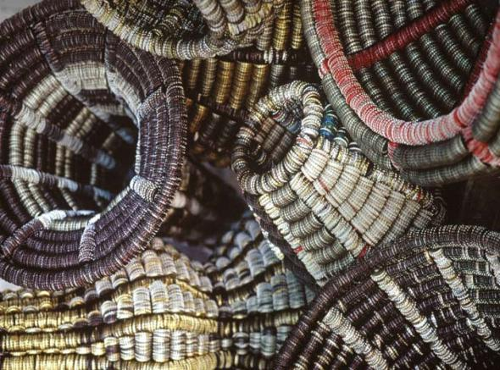

Slide 36
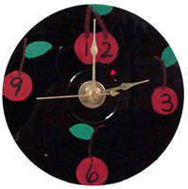
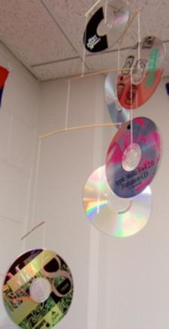
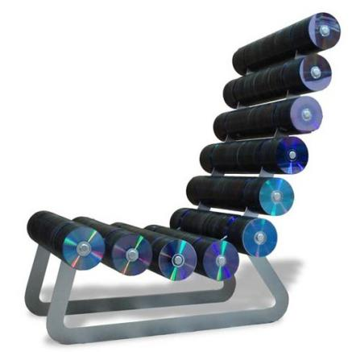
Reusing materials
Everyone can recycle old CDs:
CD Clocks
CD garden wind chimes to keep birds away
CD furniture!

Slide 37
Recycling Waste
Can your waste be recycled?
Look for a recycle symbol!
Know what can be recycled, and what can’t be recycled.
Choose products that can be recycled, or are made from recycled content.

Slide 38
Recycling Waste
The U.S. only recycles 27% of our waste – do you think we recycle more or less than other countries?
Countries like Japan and all of Europe have set higher recycling goals.
In the U.S., San Francisco is leading the charge with how much they recycle at almost 69%.
We need to be as good as SF, right?!

Slide 39
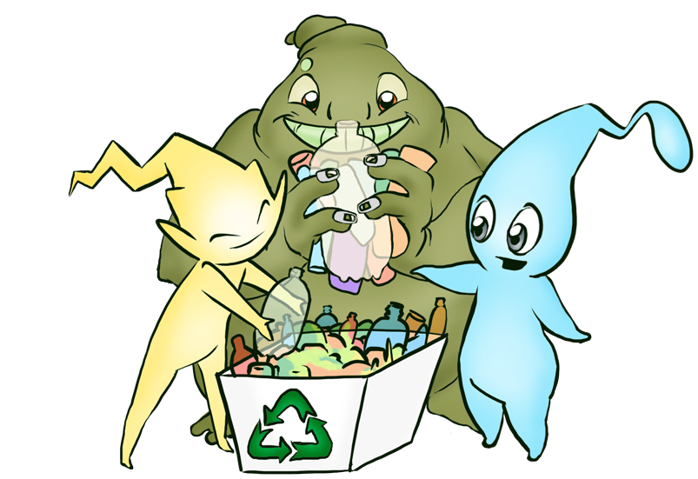
What can be recycled?
For curbside pickup:
Paper
Plastic
Aluminum
Steel
Glass

Slide 40
What can be recycled?
Take to special recycling
stations:
Batteries
Paint
Oil
Fluorescent lamps
Thermometers
Electronics

Slide 41
Why make compost?
Compost provides nutritive soil for gardens and orchards
Composting is an inexpensive way to enrich soil
Composting in gardens requires less water

Slide 42
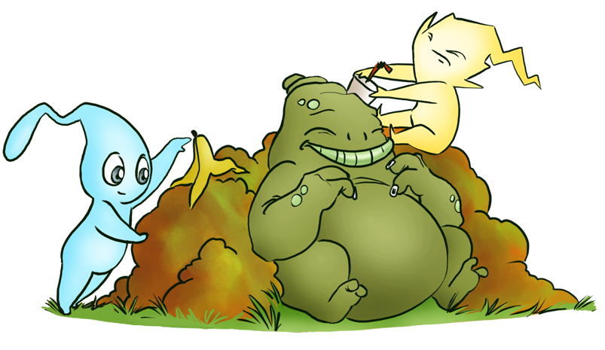
Composting Recipe
Air, Water, Plants &
Biodegradable materials

Slide 43
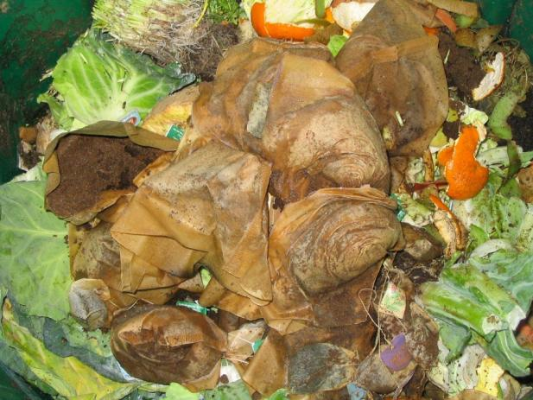
How to make Compost
Good for grass clippings/green yard waste
Food scraps like fruit and vegetable skins
Add brown leaves + shredded paper for carbon
Do not compost meat or pet droppings
Avoid pesticides + herbal treated materials
Turn pile as often as possible
Keep compost damp, but not wet
Bugs + worms are OK

Slide 44
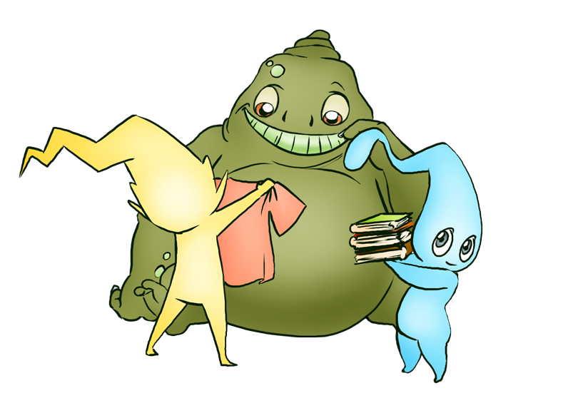
Sharing
We can share books, videos & CDs
Donate things we don’t need to others
Or take to thrift shops
Consider wearing clothing used by others
Develop a share co-op for school

Slide 45
What items can we NOT reuse?
Some things are considered true waste
Waste must be disposed of correctly
Some examples are:
Incandescent light bulbs
Used medical supplies
Unused paint or chemicals
Special items need to be verified

Slide 46
What’s it like to be waste?
Pretend that you are a piece of waste
What do you look like?
How does it feel to be thrown away?

Slide 47
Who can [produce the least waste?
Work in a small team
You will receive a bag of trash – what others call waste
Sort the trash and eliminate/save as much as possible
Use the methods we learned for reducing waste:
REDUCE, REUSE, RECYCLE, COMPOST, SHARE
Know what does need to go into the trash bin

Slide 48
Waste Busters!
Points:
REUSE: 10 Points
RECYCLE: 3 Points
COMPOST: 8 Points
SHARE: 10 Points
DISPOSE in trash if required: 0 points
DISPOSE in trash but NOT required: -2 points

Slide 49
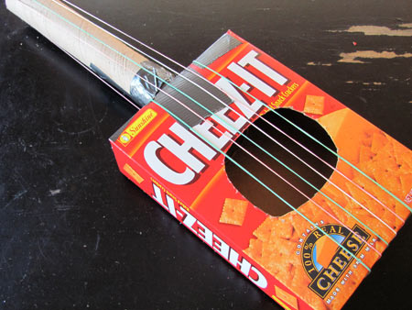
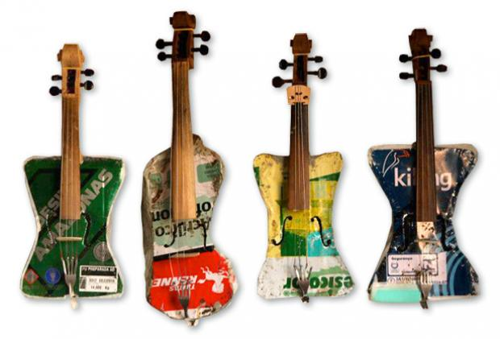
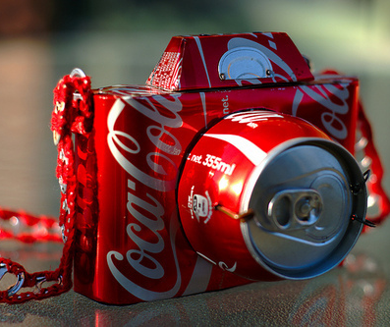
Waste Busters!
Examples….

Slide 50
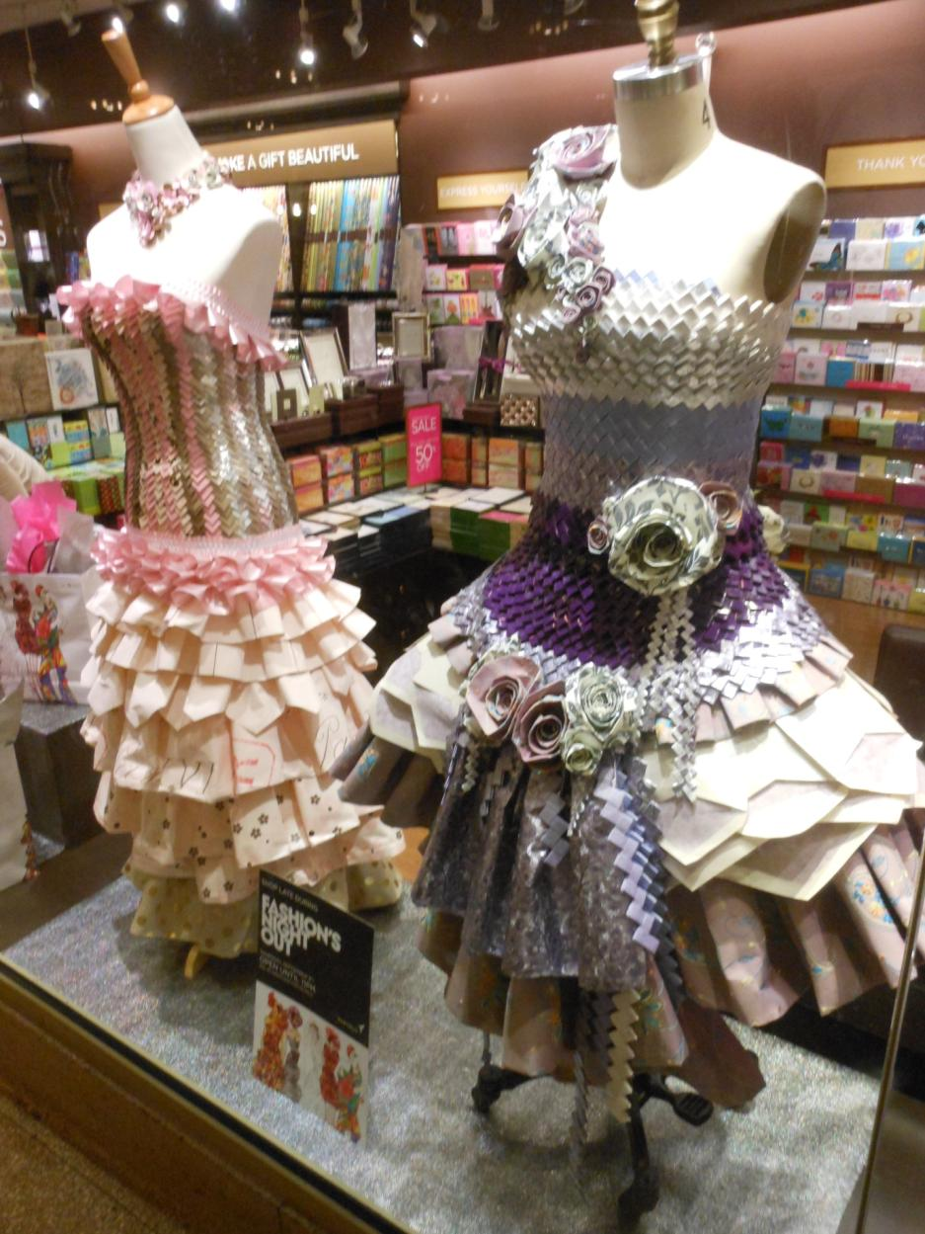

Slide 51
Summary
What can you do to help reduce our waste problem?

Slide 52
References
Household Hazardous Waste Center – 2500 Michigan Ave (310–458-8255)
Hazardous Materials – drop off sites
http://www.smgov.net/Departments/OSE/Categories/Hazardous_Materials/Neighborhood_Drop-off_Sites.aspx

