Slide 1
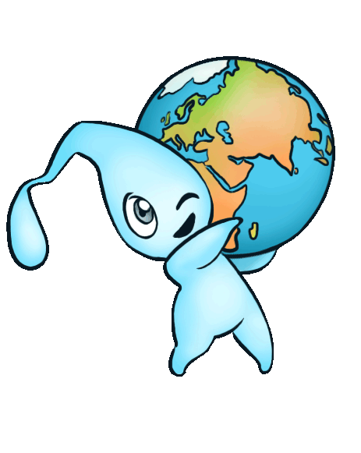
Water and Climate Change

Slide 2
Water is…
fun!

Slide 3
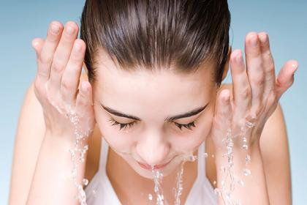
Water is…
cooling

Slide 4
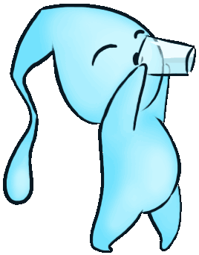
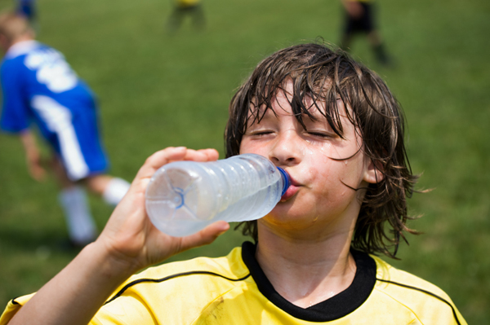
Water is…
Thirst
Quenching

Slide 5
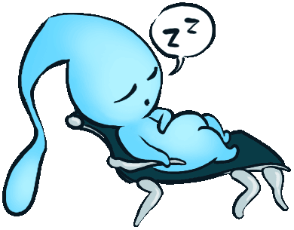
Water is…
relaxing

Slide 6
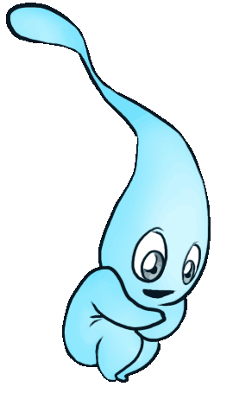
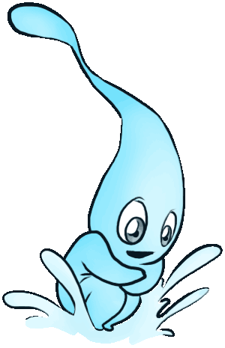
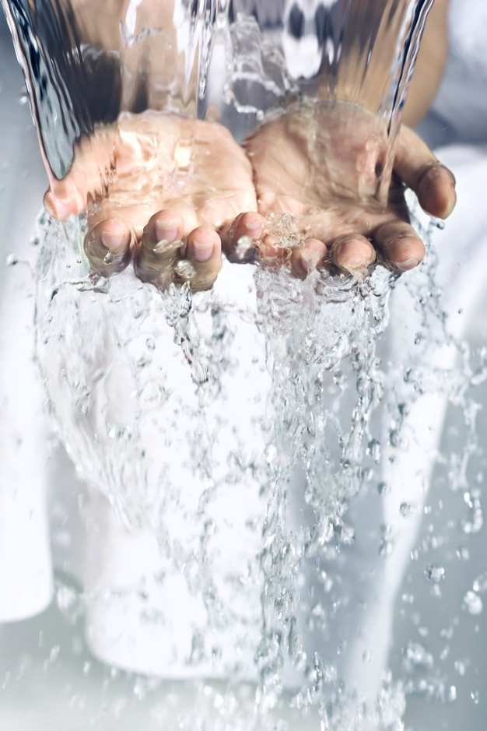
Water is…
Cleansing

Slide 7
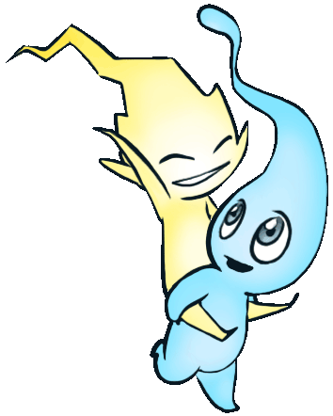
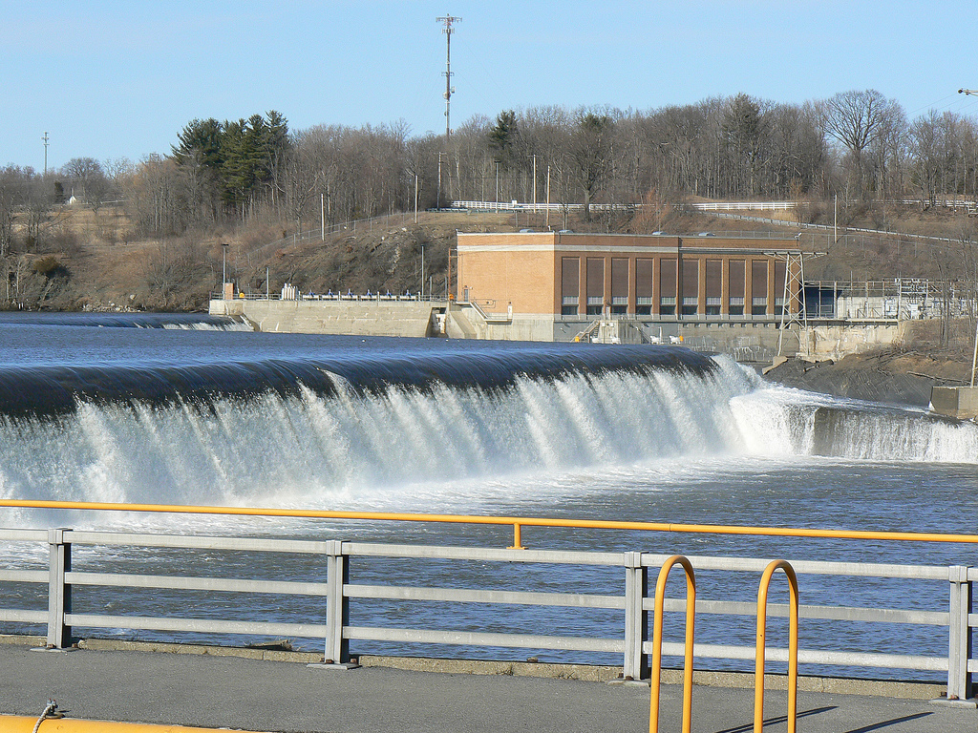
Water is…
Energizing

Slide 8
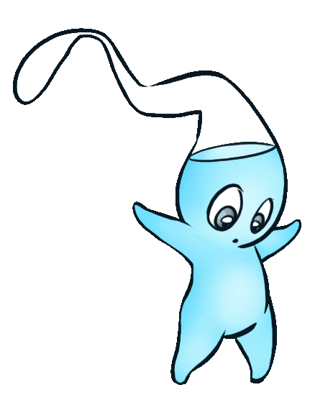
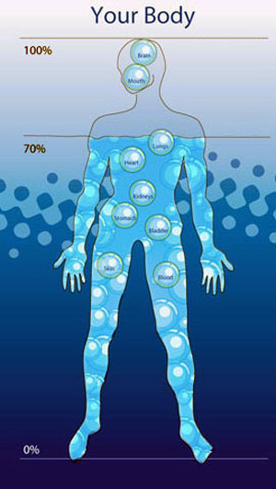
Water is…
75% of
Our bodies

Slide 9
Water is…
75% of
The Earth

Slide 10
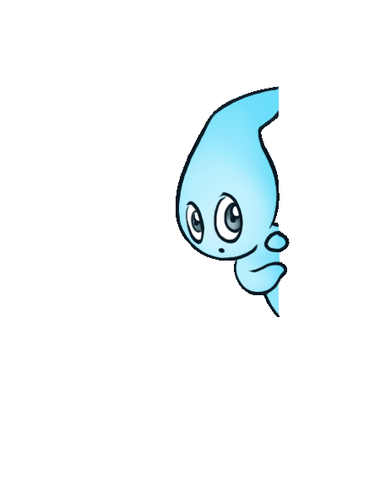
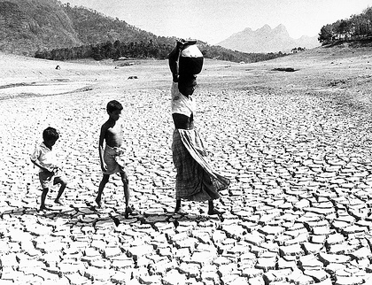
Water is…
Precious
Scarce

Slide 11
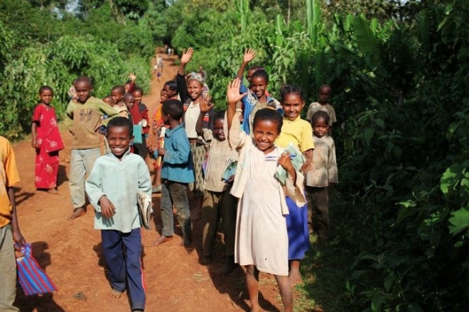
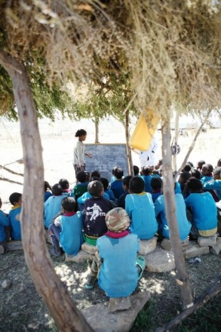
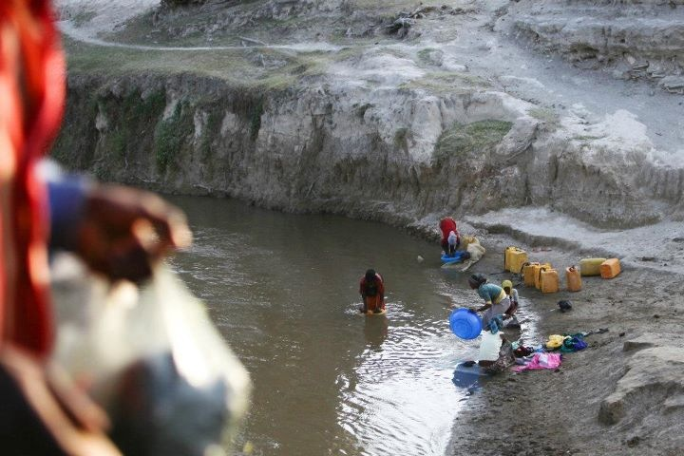
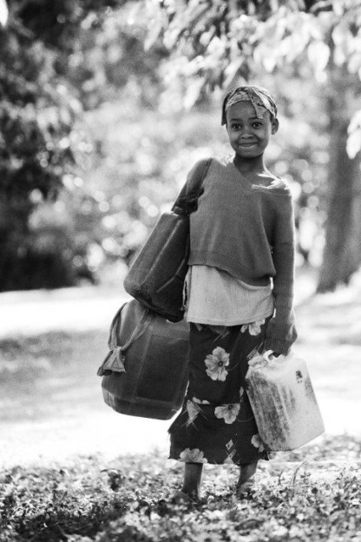
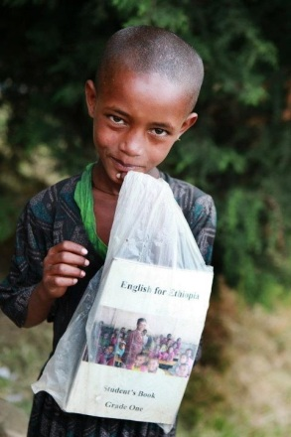
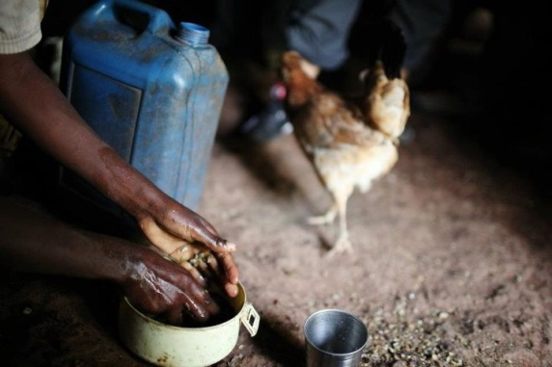
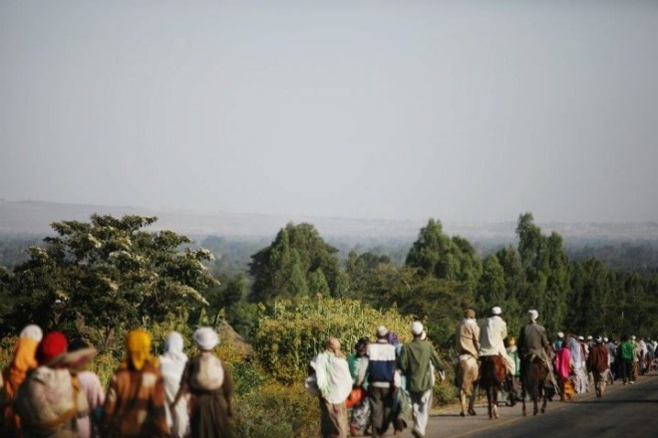
Water is…

Slide 12
Water I.Q.
What % of water on
Earth is in the Oceans?
a. 67%
b. 77%
c. 87%
d. 97%
d. 97%
EPA Water Trivia Facts, 2014 (http://water.epa.gov/learn/kids/drinkingwater/water_trivia_facts.cfm)

Slide 13
Water I.Q.
What % of the water on earth is freshwater? (Water you can drink)
a. 1% %
b. 3 %
c. 5 %
d. 10 %
b. 3%
About 2.4% of the world’s water is frozen, and therefore unusable.
1.3% of the world’s fresh water is found in lakes, rivers streams, ponds and swamps.
68.7% of the fresh water on Earth is trapped in glaciers
30% of fresh water is in the ground
EPA Water Trivia Facts, 2014 (http://water.epa.gov/learn/kids/drinkingwater/water_trivia_facts.cfm)

Slide 14
Water I.Q.
How many gallons of water does it take to produce one slice of bread?
a. 1 Gallon
b. 2 Gallons
c. 3 Gallons
d. 10 Gallons
d. 10 Gallons
EPA Water Trivia Facts, 2014 (http://water.epa.gov/learn/kids/drinkingwater/water_trivia_facts.cfm)

Slide 15
Water I.Q.
How long can a person live without food?
a. 1 week
b. 2 weeks
c. 3 weeks
d. 4 weeks
d. 4 weeks
EPA Water Trivia Facts, http://www.epa.gov/region7/kids/drnk_b.htm

Slide 16
Water I.Q.
How long can a person live without water?
a. 1 week
b. 2 weeks
c. 3 weeks
d. 4 weeks
1 week
A person can live about a month without food, but can live only about 1 week without water.
EPA Water Trivia Facts, http://www.epa.gov/region7/kids/drnk_b.htm

Slide 17
Why is Water important?
It is a limited resource. Fresh water is a scarce resource, only 3% of the water on this planet is usable for drinking.
You can help preserve water supplies for future generations, save money, and protect the environment.

Slide 18
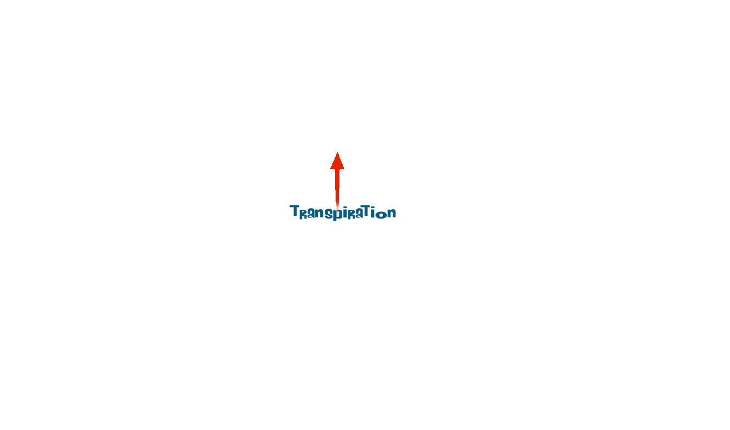
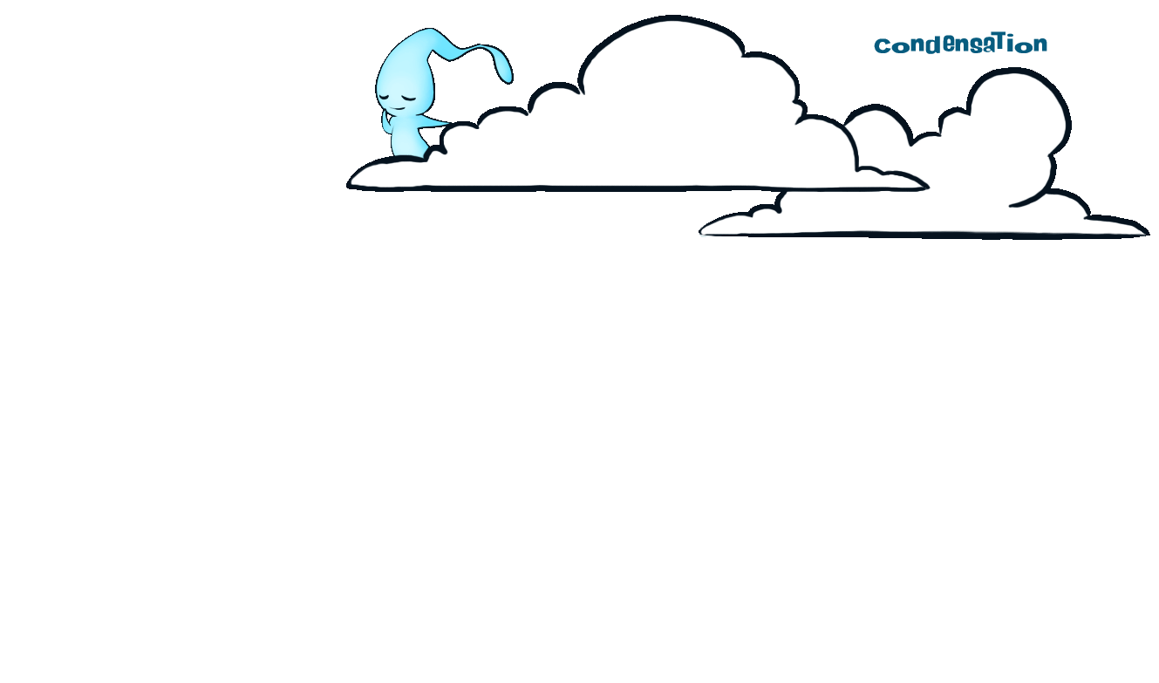
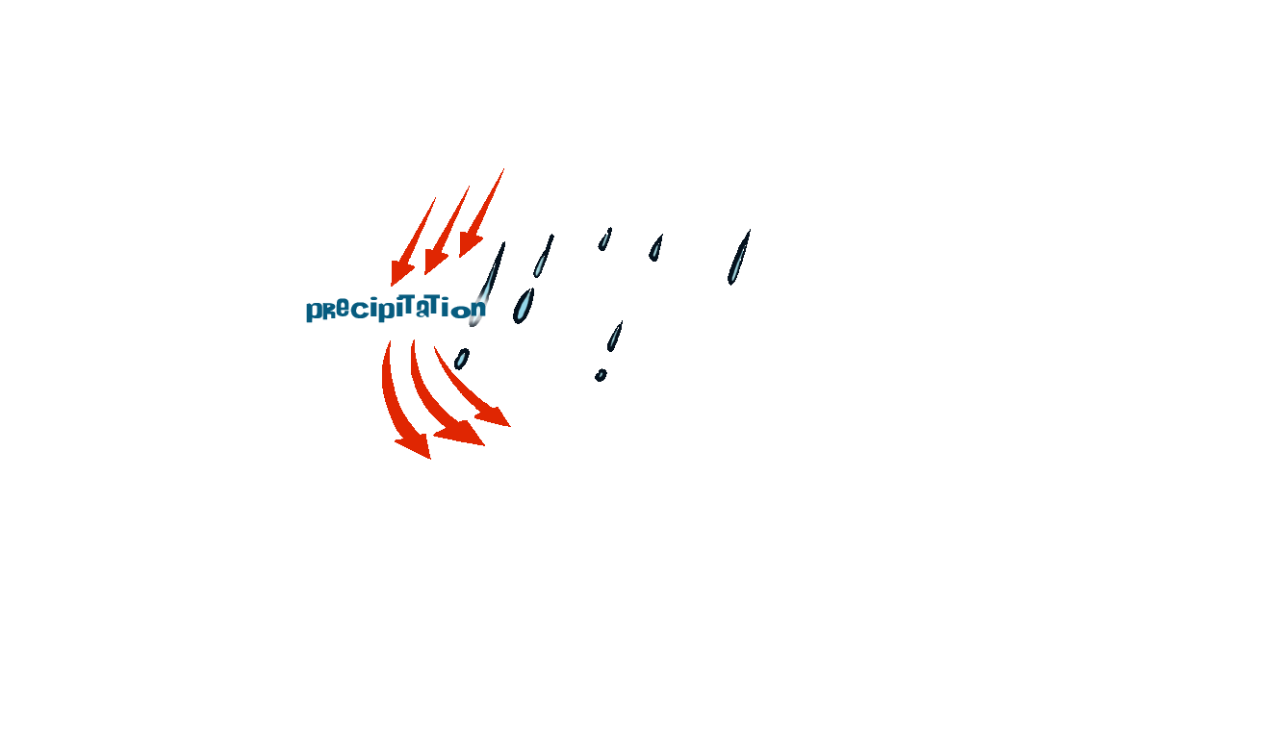
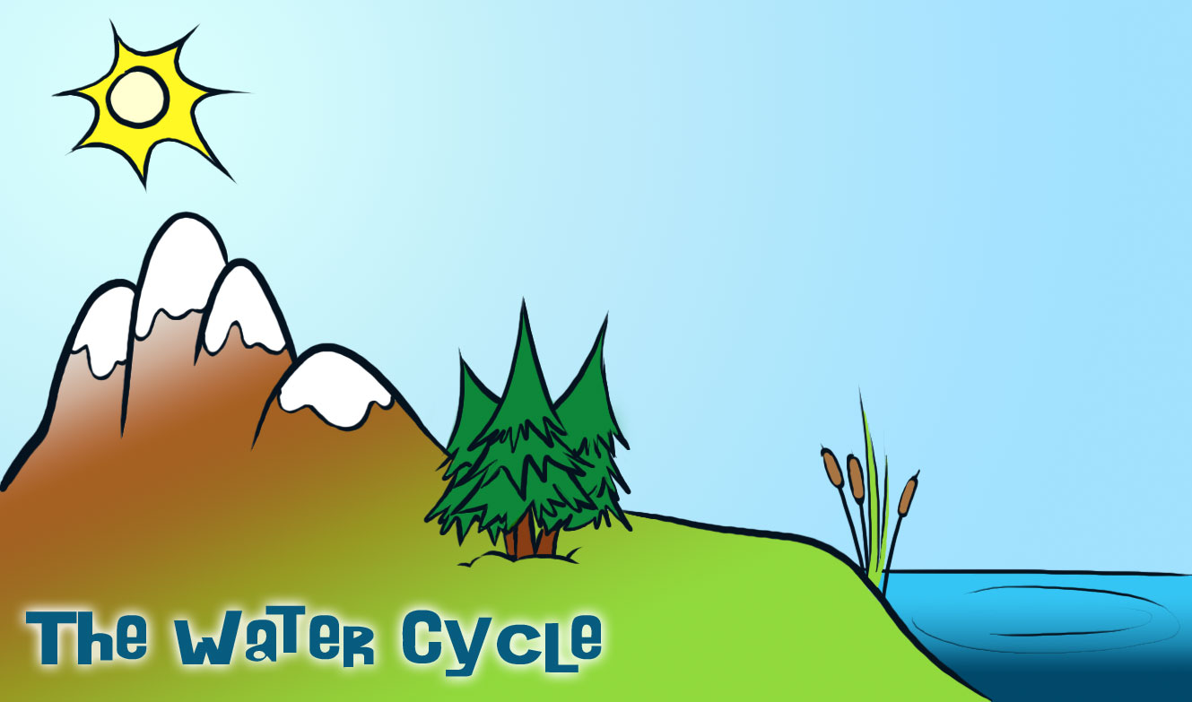
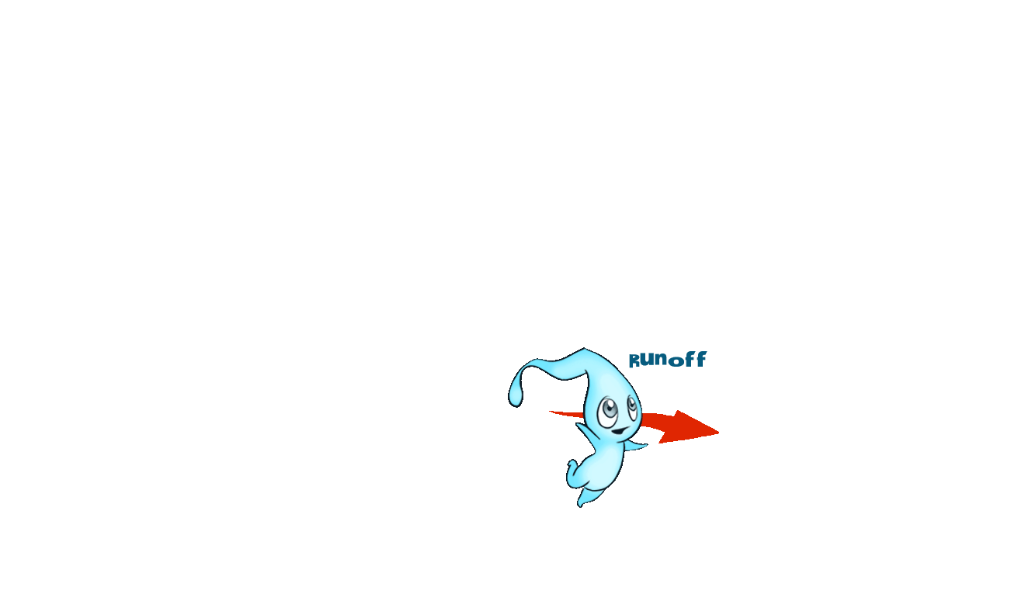
Where does the water come from?
The Water Cycle:
Evaporation, Condensation, Precipitation

Slide 19
The Water Cycle Song
Sing to “She’ll be coming around the mountain when she comes….”
https://www.youtube.com/watch?v=xcYqSN3dKq4
Or water cycle rap:
https://www.youtube.com/watch?v=gwoy_nxLPLw

Slide 20
How do people get their water?
Lakes or rivers (surface water)
OR from water that comes from wells (groundwater)
Many people in this area who live in large cities or towns get their water for drinking from lakes and rivers. But, most people in the United States get their drinking water from groundwater.

Slide 21
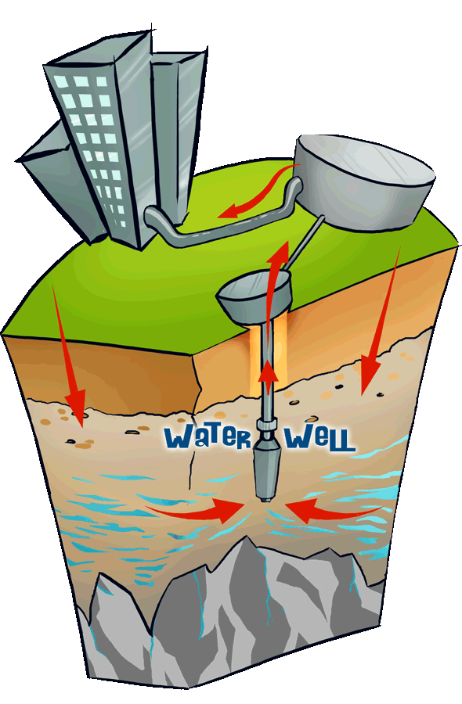
What is Groundwater?
Groundwater is stored in the ground in materials like gravel or sand.
It's kind of like the earth is a big sponge holding all that water.
Water can also move through rock formations like sandstone or through cracks in rocks.
http://water.epa.gov/learn/kids/drinkingwater/teachers_4-8.cfm
Notes:
An area that holds a lot of water, which can be pumped up with a well, is called an aquifer. Wells pump groundwater from the aquifer and then pipes deliver the water to cities, houses in the country, or to crops.
Most groundwater is clean, but groundwater can become polluted, or contaminated. It can become polluted from leaky underground tanks that store gasoline, leaky landfills, or when people apply too much fertilizer or pesticides on their fields or lawns. When pollutants leak, spill, or are carelessly dumped on the ground they can move through the soil.
Because it is deep in the ground, groundwater pollution is generally difficult and expensive to clean up. Sometimes people have to find new places to dig a well because their own became contaminated.

Slide 22
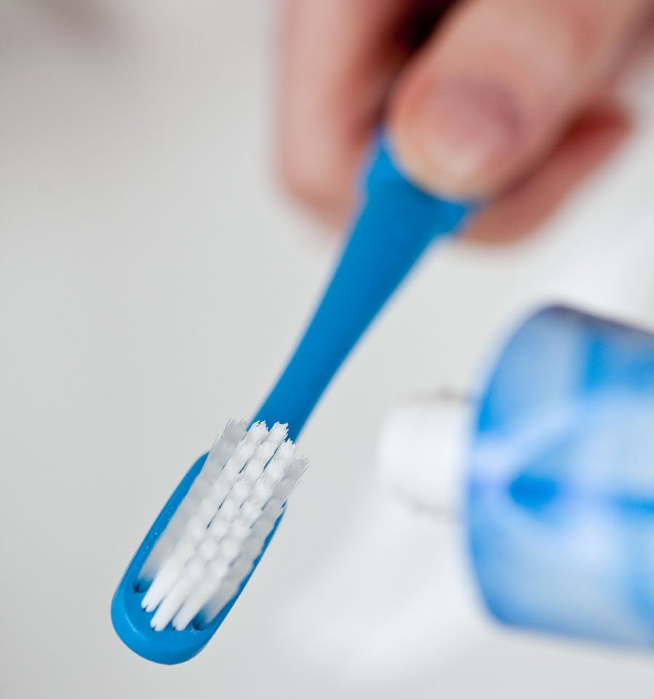
Where does the water go?
After you brush your teeth or wash the dishes…
Notes:
An area that holds a lot of water, which can be pumped up with a well, is called an aquifer. Wells pump groundwater from the aquifer and then pipes deliver the water to cities, houses in the country, or to crops.
Most groundwater is clean, but groundwater can become polluted, or contaminated. It can become polluted from leaky underground tanks that store gasoline, leaky landfills, or when people apply too much fertilizer or pesticides on their fields or lawns. When pollutants leak, spill, or are carelessly dumped on the ground they can move through the soil.
Because it is deep in the ground, groundwater pollution is generally difficult and expensive to clean up. Sometimes people have to find new places to dig a well because their own became contaminated.

Slide 23
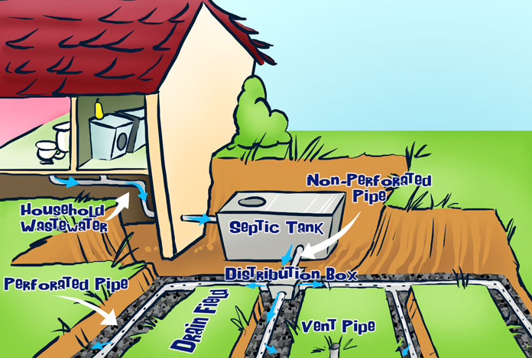
Where does the water go?
…it’s sent to a Septic Tank where it eventually seeps back into the ground…
OR…
Notes:
An area that holds a lot of water, which can be pumped up with a well, is called an aquifer. Wells pump groundwater from the aquifer and then pipes deliver the water to cities, houses in the country, or to crops.
Most groundwater is clean, but groundwater can become polluted, or contaminated. It can become polluted from leaky underground tanks that store gasoline, leaky landfills, or when people apply too much fertilizer or pesticides on their fields or lawns. When pollutants leak, spill, or are carelessly dumped on the ground they can move through the soil.
Because it is deep in the ground, groundwater pollution is generally difficult and expensive to clean up. Sometimes people have to find new places to dig a well because their own became contaminated.

Slide 24
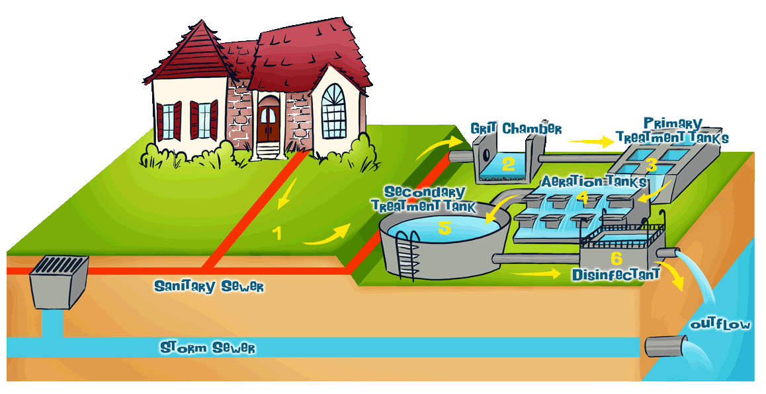
Where does the water go?
…it’s sent to a Sewage Treatment plant through the sewer system…
AFTER THAT…
Notes:
An area that holds a lot of water, which can be pumped up with a well, is called an aquifer. Wells pump groundwater from the aquifer and then pipes deliver the water to cities, houses in the country, or to crops.
Most groundwater is clean, but groundwater can become polluted, or contaminated. It can become polluted from leaky underground tanks that store gasoline, leaky landfills, or when people apply too much fertilizer or pesticides on their fields or lawns. When pollutants leak, spill, or are carelessly dumped on the ground they can move through the soil.
Because it is deep in the ground, groundwater pollution is generally difficult and expensive to clean up. Sometimes people have to find new places to dig a well because their own became contaminated.

Slide 25
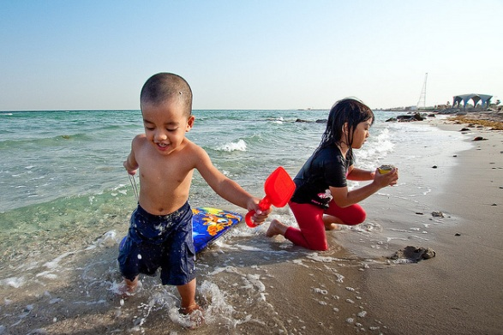
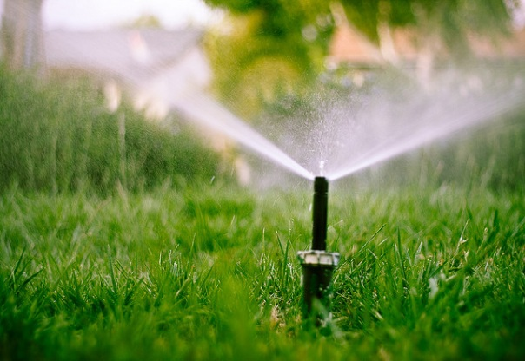
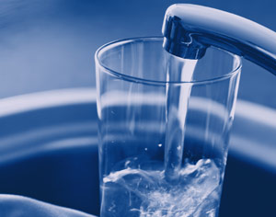
Where does the water go?
To the ocean
OR…
Used for irrigation
OR…
To our tap water
Notes:
An area that holds a lot of water, which can be pumped up with a well, is called an aquifer. Wells pump groundwater from the aquifer and then pipes deliver the water to cities, houses in the country, or to crops.
Most groundwater is clean, but groundwater can become polluted, or contaminated. It can become polluted from leaky underground tanks that store gasoline, leaky landfills, or when people apply too much fertilizer or pesticides on their fields or lawns. When pollutants leak, spill, or are carelessly dumped on the ground they can move through the soil.
Because it is deep in the ground, groundwater pollution is generally difficult and expensive to clean up. Sometimes people have to find new places to dig a well because their own became contaminated.

Slide 26
What can we do?
Conserve- reduce quantity of water used
Don’t let it run - Fix the drip!
Close the hose
Irrigate Wisely
Check the plumbing
Take the 5 Minute Challenge!
An average shower in the U.S. is 8 minutes long, and uses about 2 gallons of water per minute– that’s about 16 gallons for one shower!
By taking a shower that’s 5 minutes or less, you can save 6 gallons each day. That’s 2,190 gallons per year that YOU can save!
Notes:
Don’t let it run. We have all developed the bad habit of letting the faucet run while wait for the shower to warm up, while we brush our teeth, or while wait for a cold glass of water. Keeping a pitcher of water in the refrigerator or turning the faucet off while we brush our teeth can save several gallons of water each day! It’s simple really, before you turn on the tap, think of ways you can use less water to accomplish the same purpose.
Fix the drip. There is no such thing as a little drip. A leaky faucet with a drip of just 1/16 of an inch in diameter (about this big –o–) can waste 10 gallons of water every day. You can turn off that drip by replacing worn washers or valve seats with the help of your parents. The silent leak. Even worse than the careless hand on the faucet is the silent toilet bowl leak, probably the single greatest water waster in homes. A leak of one gallon every 24 minutes—an average amount—totals 2.5 gallons per hour or 60 gallons per day! To check your toilet for a leak, place a few drops of food coloring in the tank and wait. If the color appears in the bowl, then there’s a leak. Often these leaks can be fixed with a few minor adjustments, cleaning calcium deposits from the toilet ball in the tank, or by replacing worn valves.
Close the hose. Letting the garden hose run faster or longer than necessary while we water the lawn or wash the car often becomes a careless and wasteful habit. A ½ inch garden hose under normal water pressure pours out more than 600 gallons of water per hour and a ¾ inch hose delivers almost 1,900 gallons in the same length of time. If left on overnight, one garden hose can easily waste twice as much water as the average family uses in a month.
Irrigate Wisely. We have all seen the neighbor waters their lawn during an afternoon thunder storm. We have all seen the corner business whose whose automatic sprinkler system consistently over-waters causing sheets of water to flow across sidewalks and parking lots. Be wise, watch the weather and irrigate only during the cooler parts of the day (early morning or late evening). How do you know if you lawn requires water? Try the step test. If you walk across your lawn and the grass does not spring back up, then it's time to water. Most grass varieties require minimal watering (1/4 - 1/2 inches, once or twice a week). Set a small cup next to your sprinkler to measure the amount your particular sprinkler delivers.
Check the plumbing. Proper maintenance is one of the most effective water savers. Faucet washers are inexpensive and take only a few minutes to replace. At home, check all water taps, hoses, and hose connections (even those that connect to dishwashers and washing machines) for leaks. Check the garden hose too—it should be turned off at the faucet, not just at the nozzle.
The 5 Minute Challenge. A quick shower uses around 20-30 gallons less water than a bath. Challenge yourself and your family members to take 5 minute showers. Use a kitchen timer to keep track. Install a water-saving showerhead for additional savings.

Slide 27
What can we do?
Protect-Uphold or improve the quality of water
Pick up litter in your neighborhood and on your school grounds.
Household hazardous waste collection day
Ride a bike, walk, rollerblade or take a skateboard instead of taking the bus or riding in a car.
Purchase "green" household cleaning alternatives
Don’t use pesticides
Never dump chemicals, waste or other toxins into a gutter or storm drain
Notes:
Pick up litter in your neighborhood and on your school grounds.
Encourage your friends and family to reduce, reuse, and recycle.
Talk with your school’s principal and superintendent about certification as a Groundwater Guardian Green Site.
You can go to your neighborhood or community leaders and ask them to sponsor a household hazardous waste collection day where people can bring their old paint, oil, or other chemicals to be disposed of properly.
You and your friends or family members can go around to storm drains in your area to stencil a groundwater friendly message.
Design posters or flyers in your community that educate citizens on easy ways to conserve water.
Ride a bike, walk, rollerblade or take a skateboard instead of taking the bus or riding in a car.
Encourage friends and family to purchase "green" household cleaning alternatives and to limit their use of harmful chemicals like pesticides and fertilizers.
Talk to your teacher at school about a groundwater class project or a school-wide groundwater education day.
Join a surface water monitoring club to test and track changes in a pond, stream or lake near your home.
Celebrate Earth Day, everyday.

Slide 28
What can we do?
Share your knowledge…
With your family
With your friends
With your neighbors
Notes:
An area that holds a lot of water, which can be pumped up with a well, is called an aquifer. Wells pump groundwater from the aquifer and then pipes deliver the water to cities, houses in the country, or to crops.
Most groundwater is clean, but groundwater can become polluted, or contaminated. It can become polluted from leaky underground tanks that store gasoline, leaky landfills, or when people apply too much fertilizer or pesticides on their fields or lawns. When pollutants leak, spill, or are carelessly dumped on the ground they can move through the soil.
Because it is deep in the ground, groundwater pollution is generally difficult and expensive to clean up. Sometimes people have to find new places to dig a well because their own became contaminated.

Slide 29
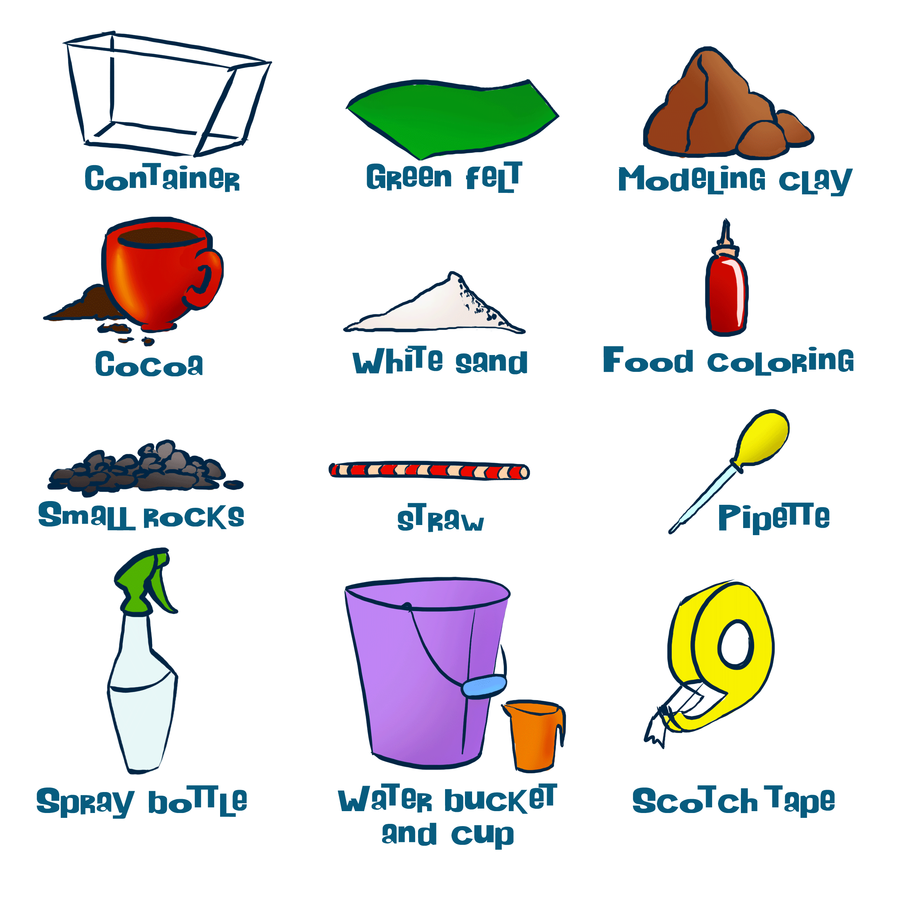
Activity: Build your own Aquifer
http://water.epa.gov/learn/kids/drinkingwater/teachers_4-8.cfm
Notes:
An area that holds a lot of water, which can be pumped up with a well, is called an aquifer. Wells pump groundwater from the aquifer and then pipes deliver the water to cities, houses in the country, or to crops.
Most groundwater is clean, but groundwater can become polluted, or contaminated. It can become polluted from leaky underground tanks that store gasoline, leaky landfills, or when people apply too much fertilizer or pesticides on their fields or lawns. When pollutants leak, spill, or are carelessly dumped on the ground they can move through the soil.
Because it is deep in the ground, groundwater pollution is generally difficult and expensive to clean up. Sometimes people have to find new places to dig a well because their own became contaminated.

Slide 30
Water… What can we do?
Would you drink this water?
What are some ways that we can prevent water from getting contaminated?
How can we protect water at home?
How can we protect water at school?
How can we conserve water at home?
How can we conserve water at school?
Notes:
An area that holds a lot of water, which can be pumped up with a well, is called an aquifer. Wells pump groundwater from the aquifer and then pipes deliver the water to cities, houses in the country, or to crops.
Most groundwater is clean, but groundwater can become polluted, or contaminated. It can become polluted from leaky underground tanks that store gasoline, leaky landfills, or when people apply too much fertilizer or pesticides on their fields or lawns. When pollutants leak, spill, or are carelessly dumped on the ground they can move through the soil.
Because it is deep in the ground, groundwater pollution is generally difficult and expensive to clean up. Sometimes people have to find new places to dig a well because their own became contaminated.

